Slide 1
Online Learning
By Abdullah Hamdi
[IVUL , KAUST 2017]

Slide 2




Not learning online !!

Slide 3
What is Online learning
Stream of data ( vs fixed training set)
Hypothesis can change with time
Test/train in the same time
Dependent training samples
applications:
Amazon product suggestion
Stock market predictors

Slide 4
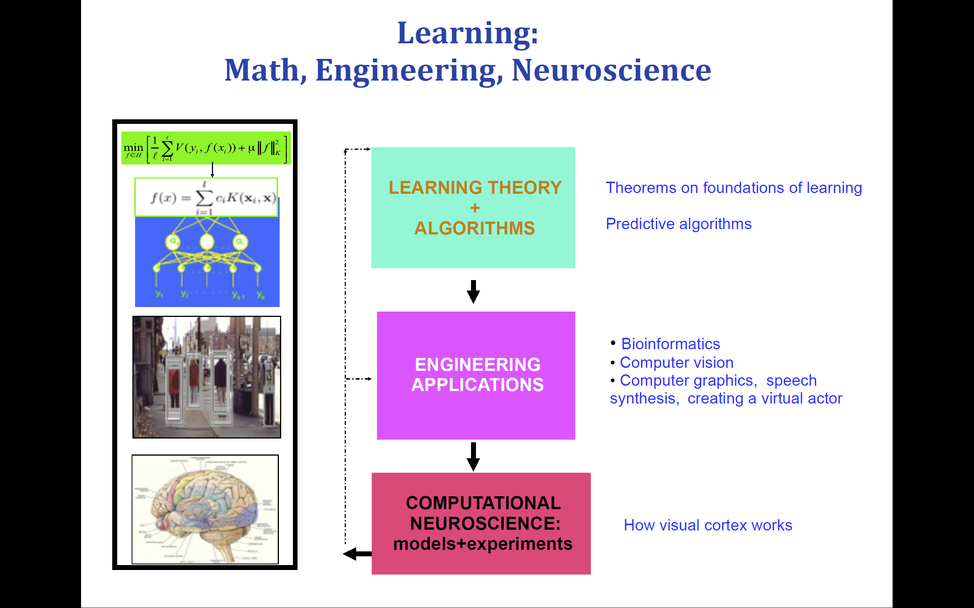

Slide 5


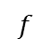
Supervised learning
P(x,y) on
We define loss
X
Y
$$f$$

Slide 6
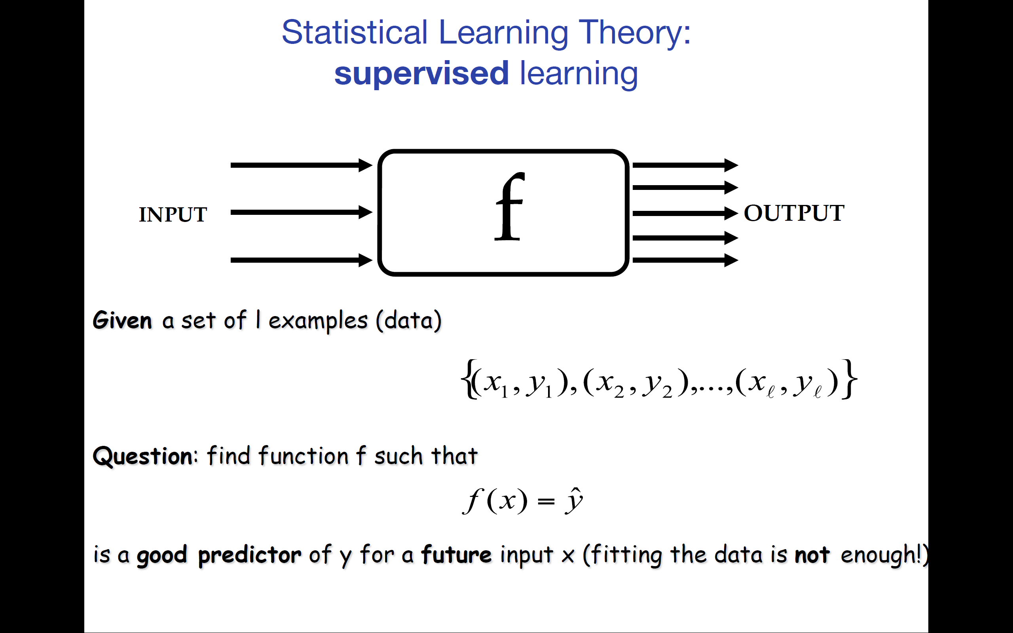

Slide 7
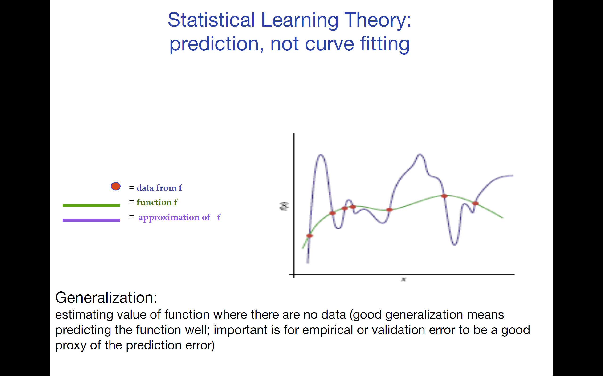

Slide 8
Supervised learning
Adversarial models (game Theory)
Statistical models
Batch learning
Online learning
SVM
GD
SGD
IGD
FTL
FTRL
OGD
OMD

Slide 9
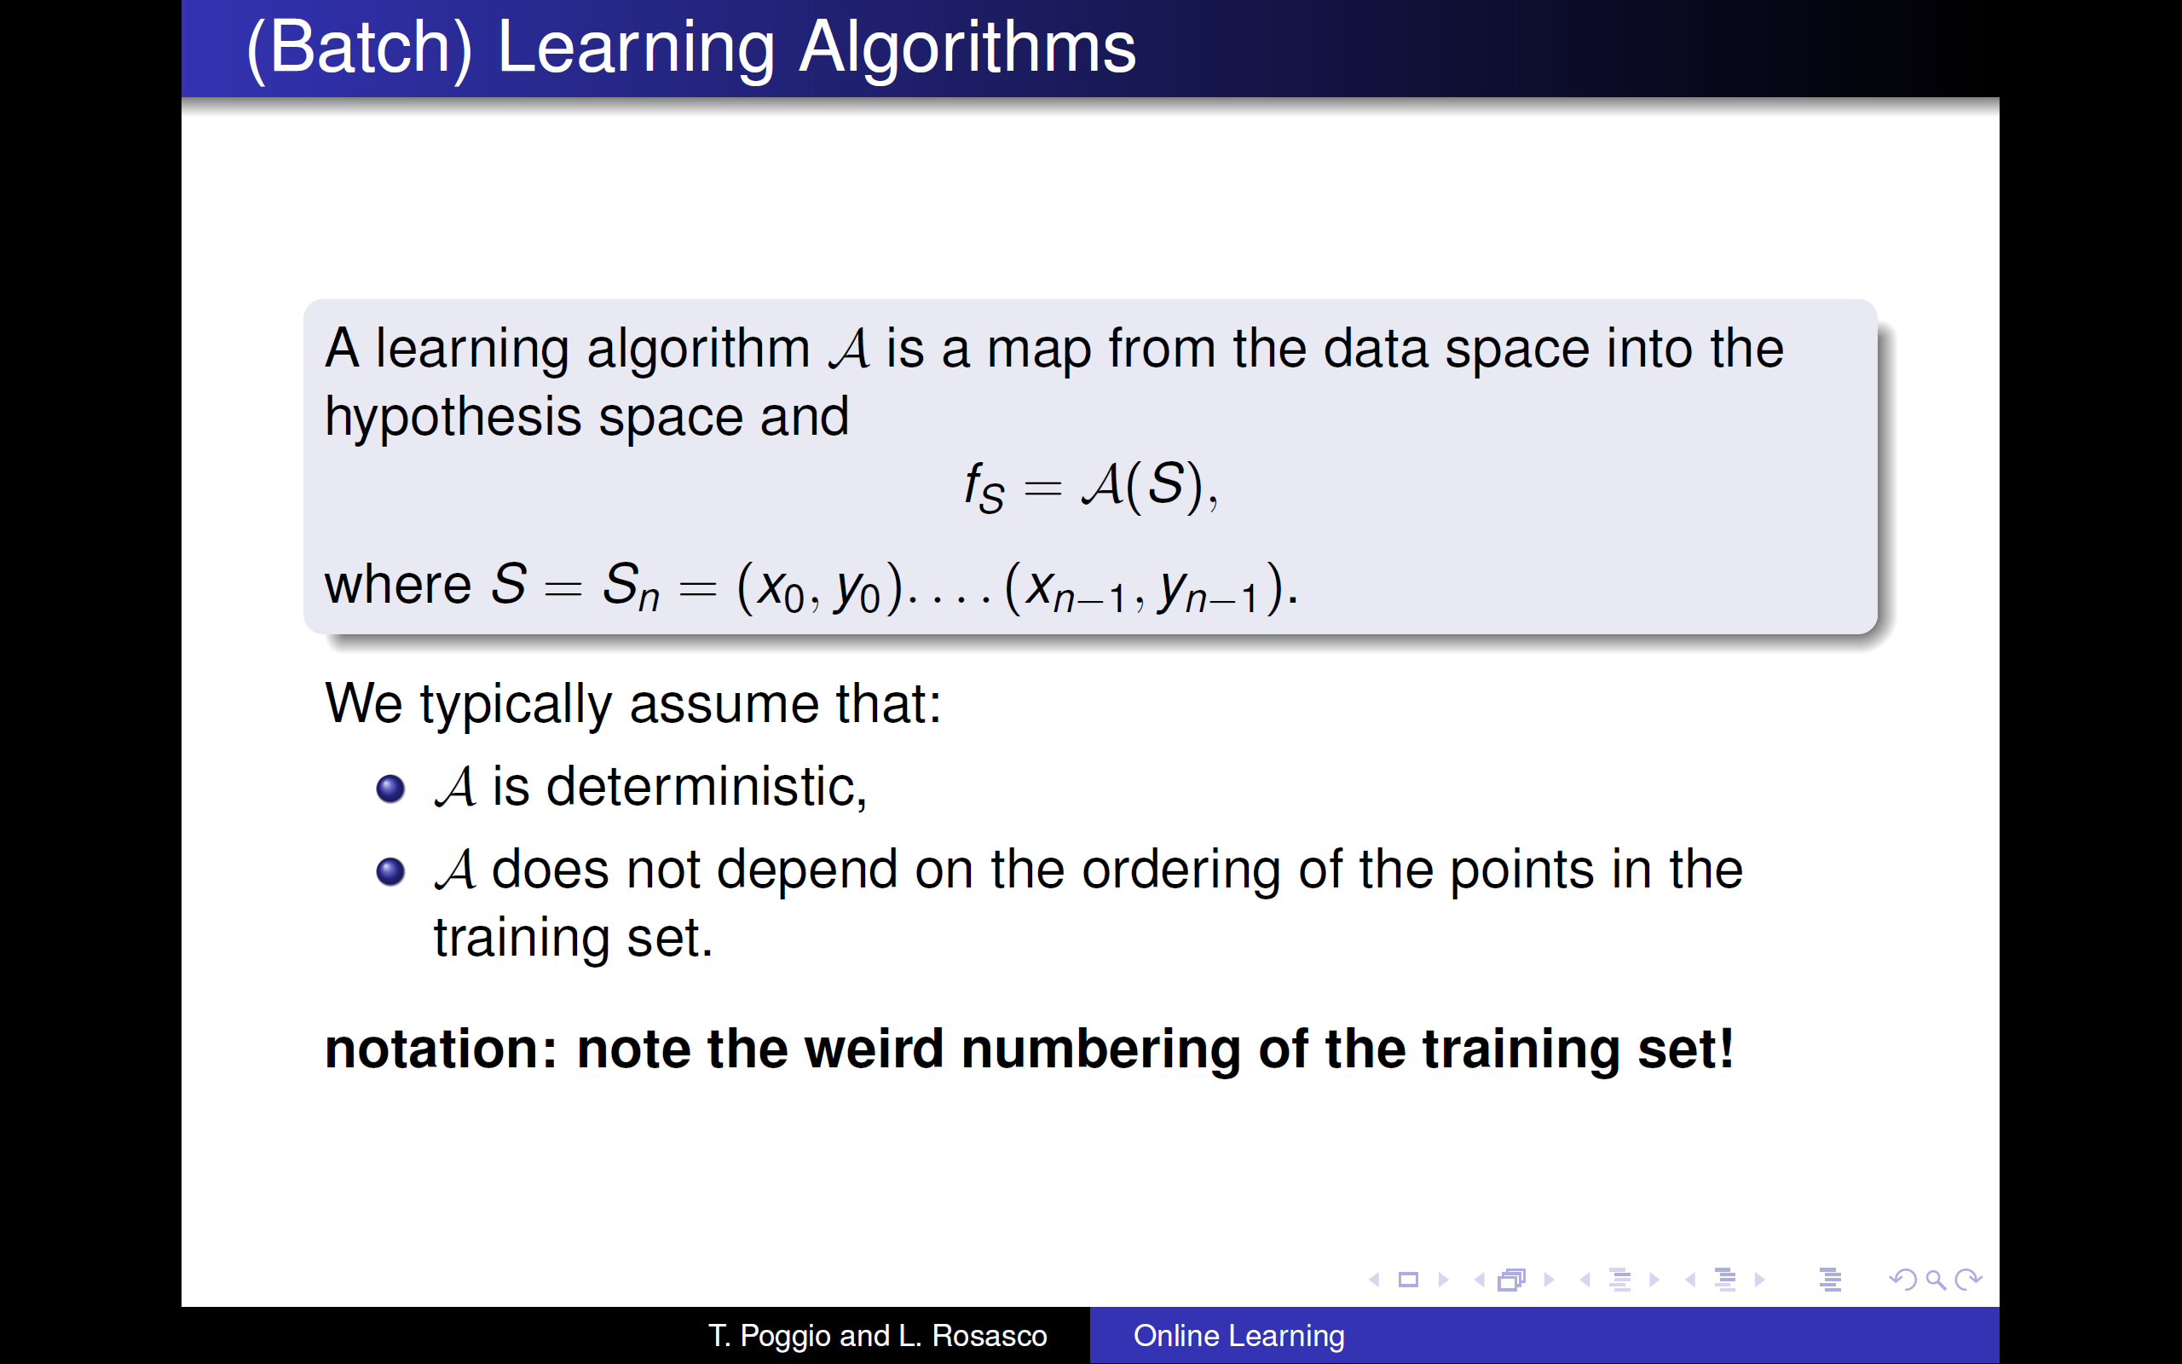

Slide 10
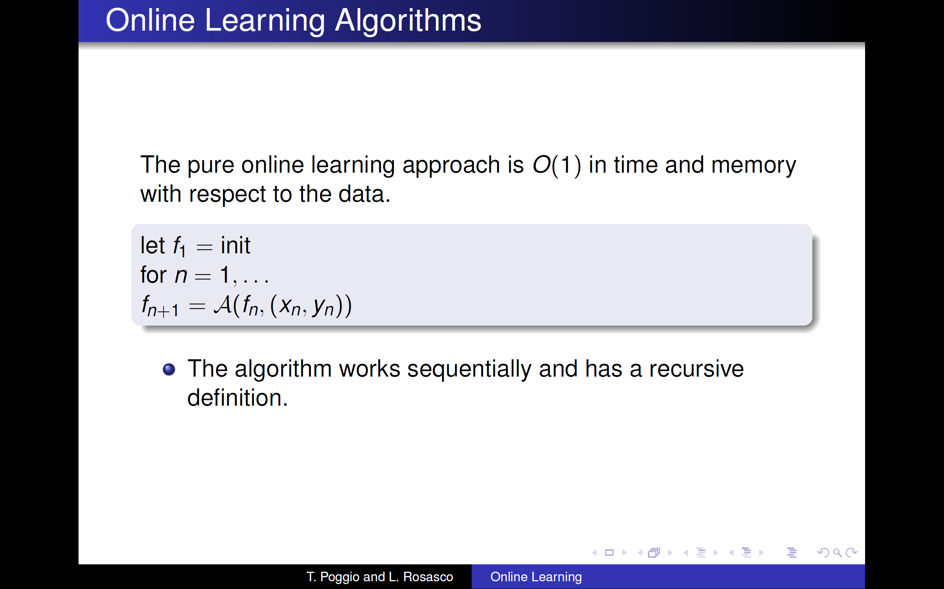

Slide 11
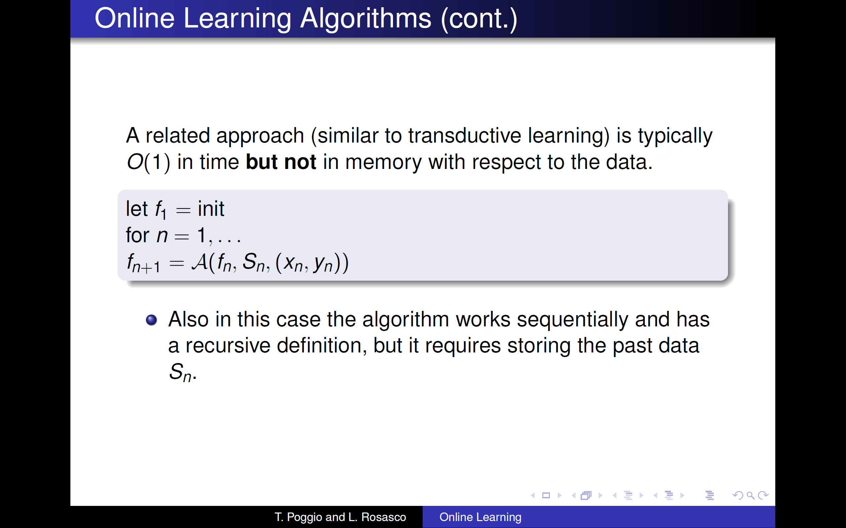

Slide 12
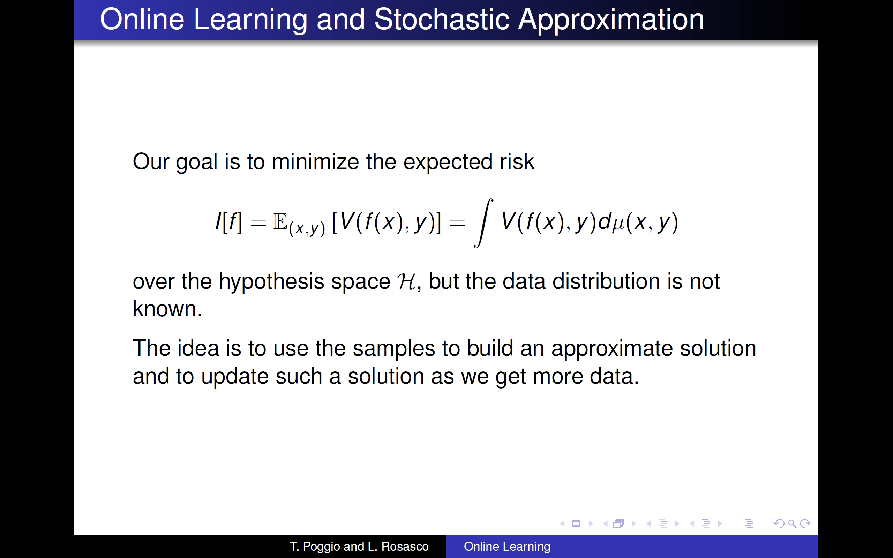

Slide 13
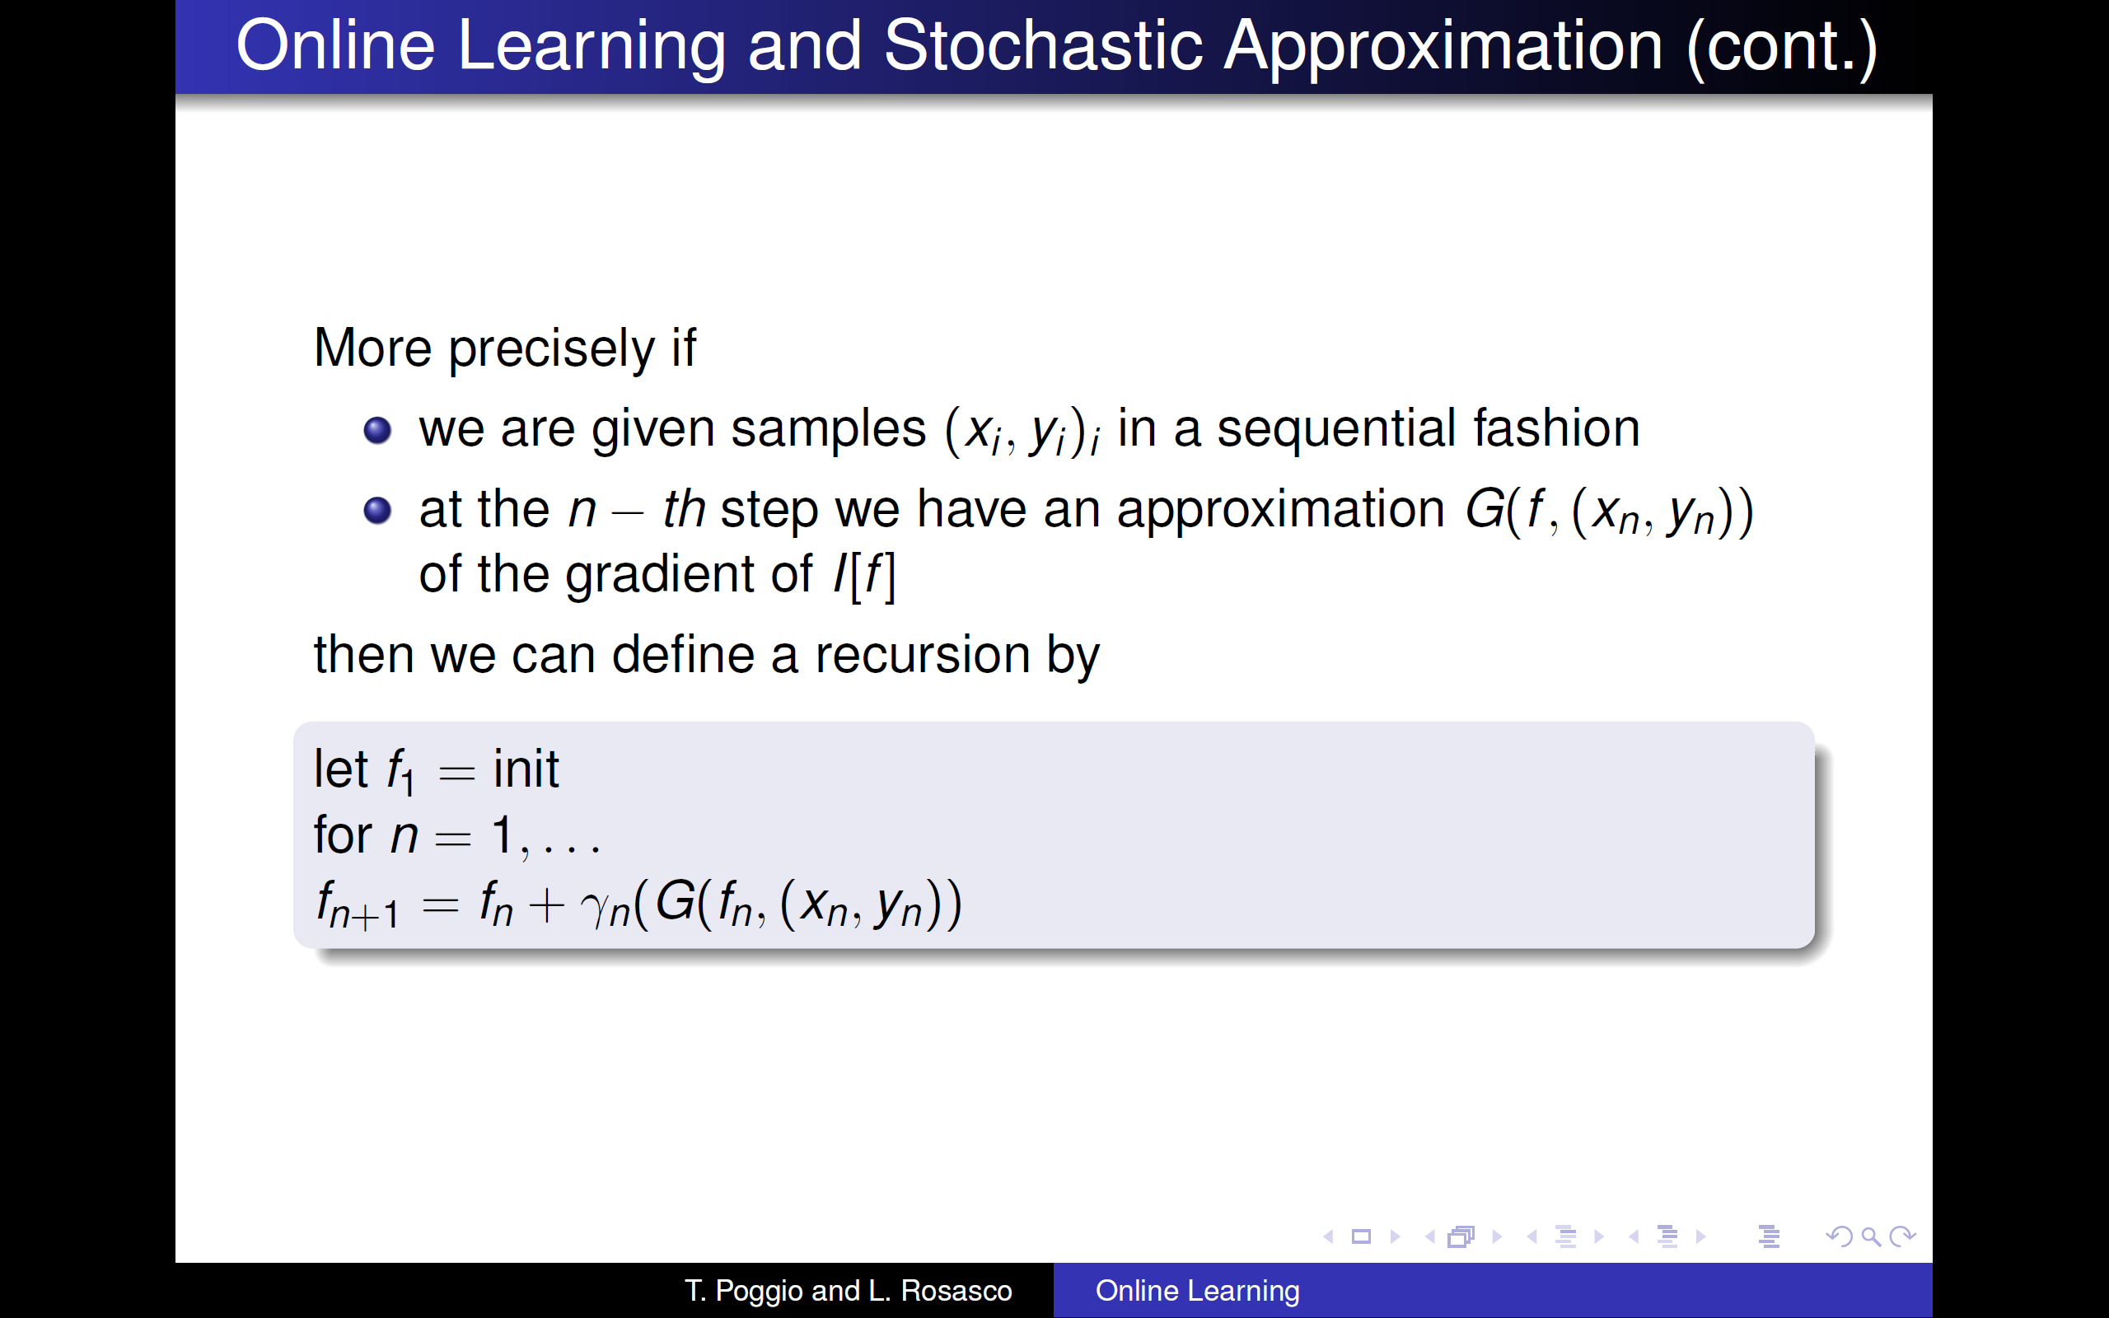

Slide 14
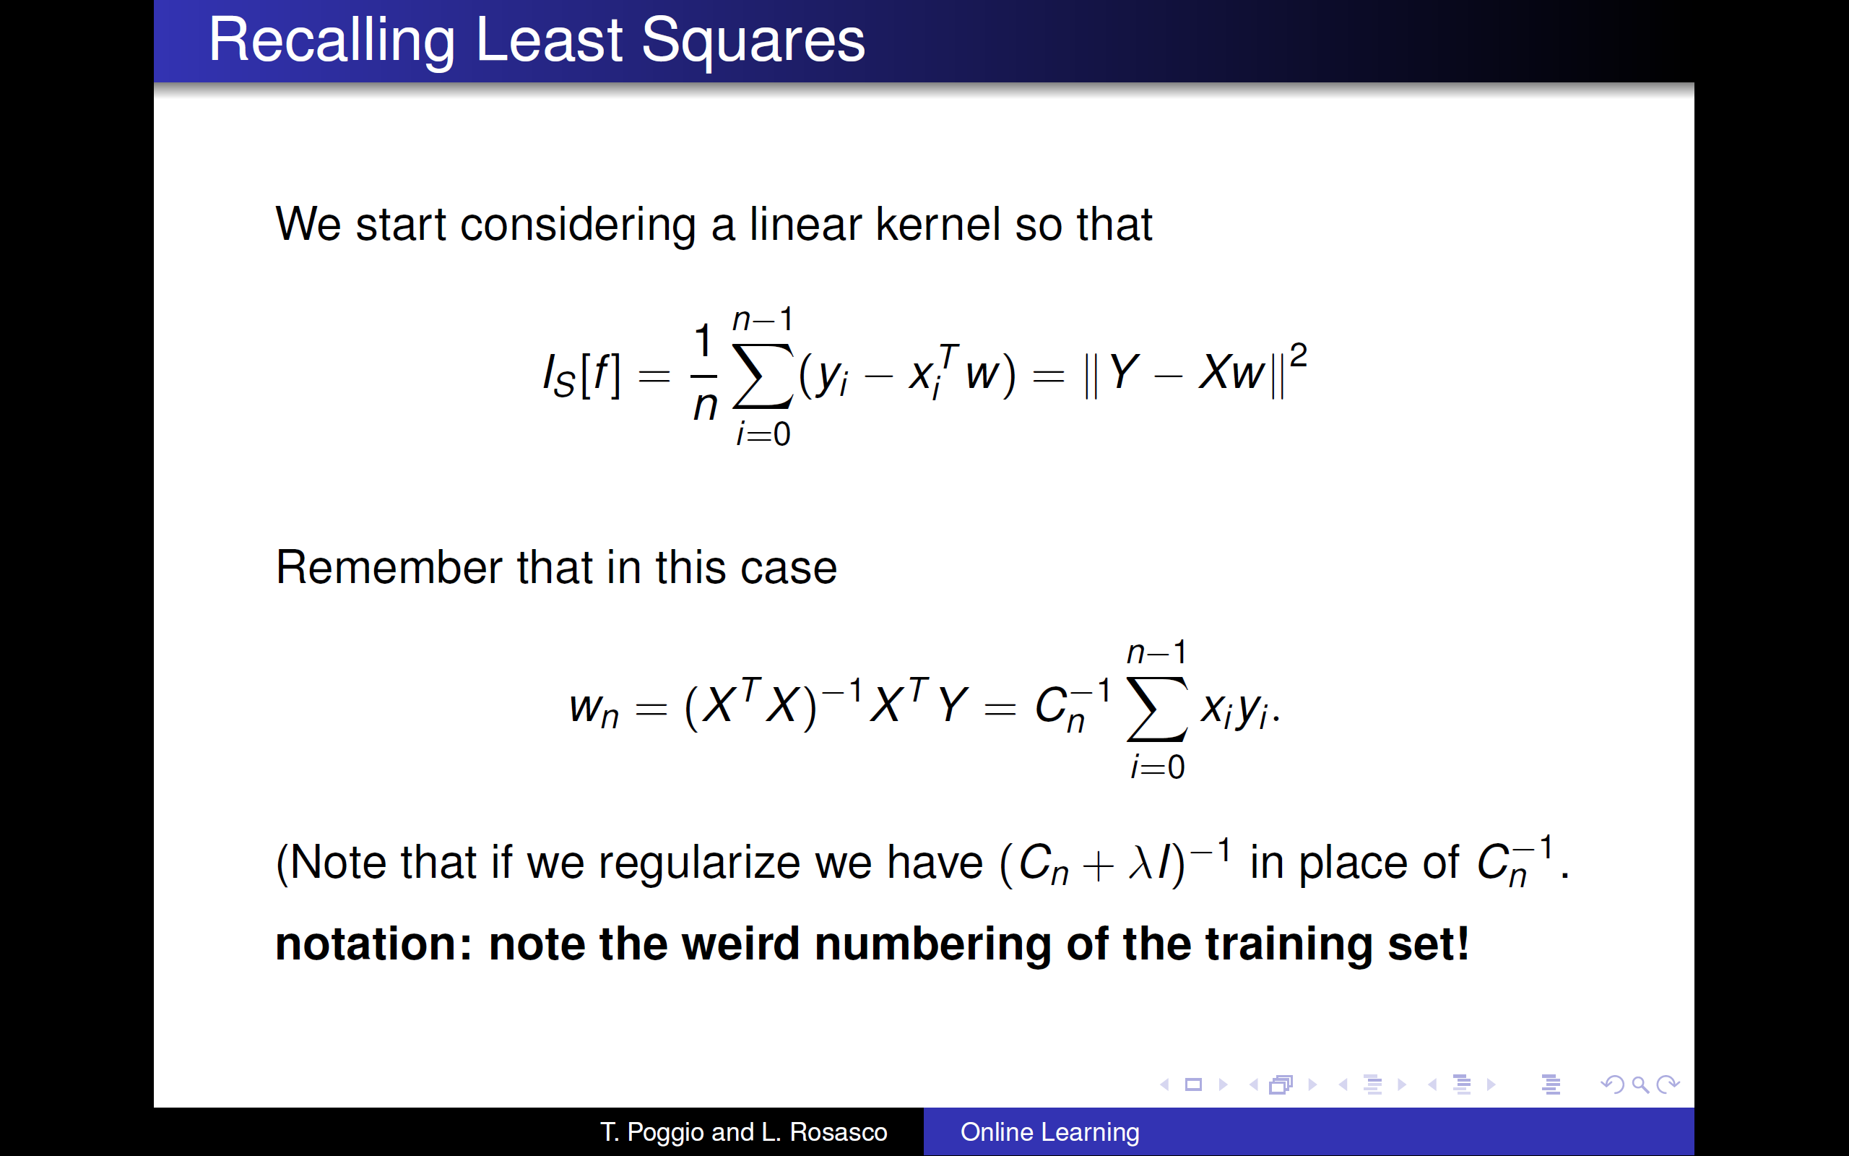

Slide 15
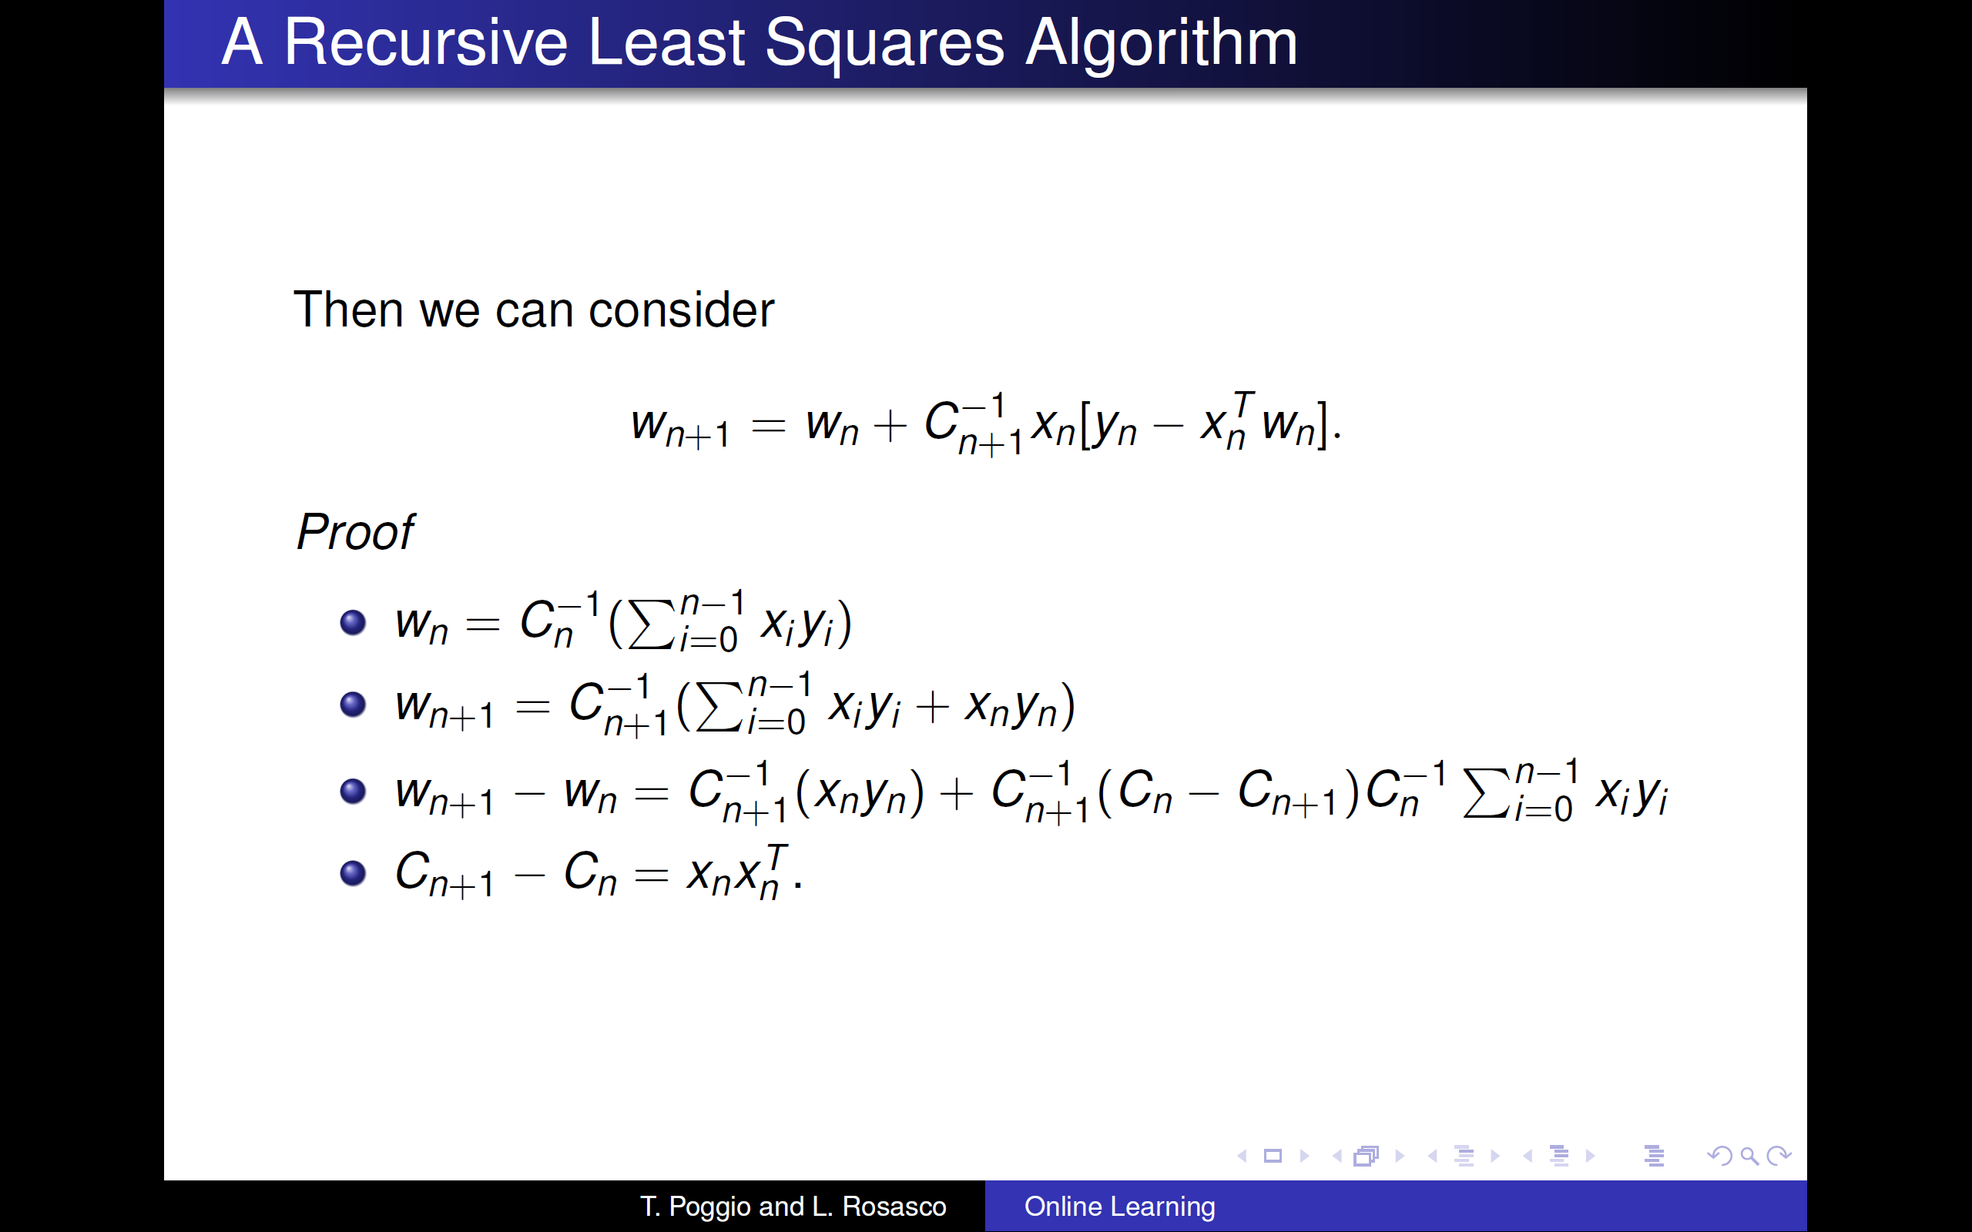

Slide 16
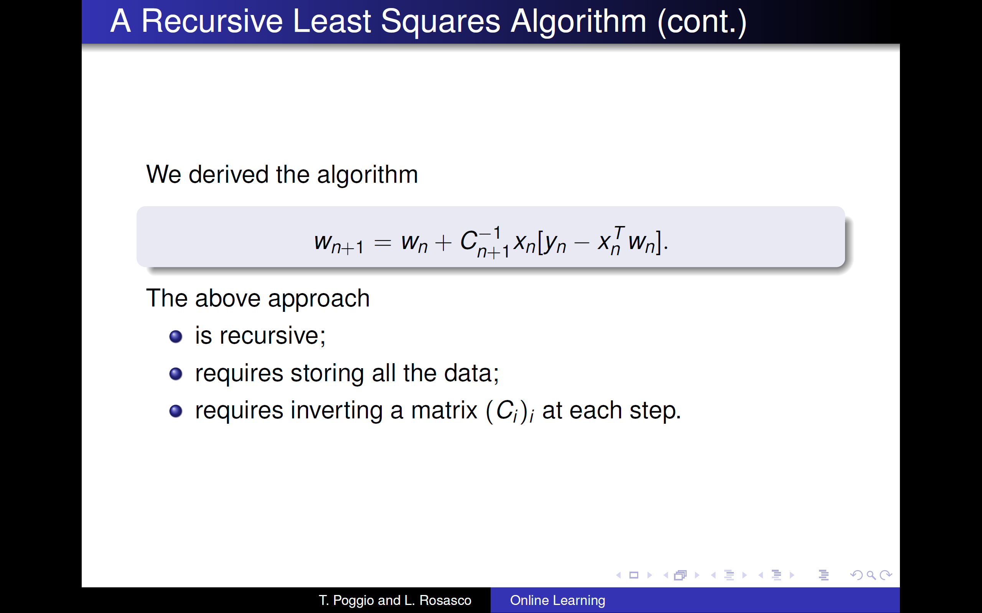

Slide 17
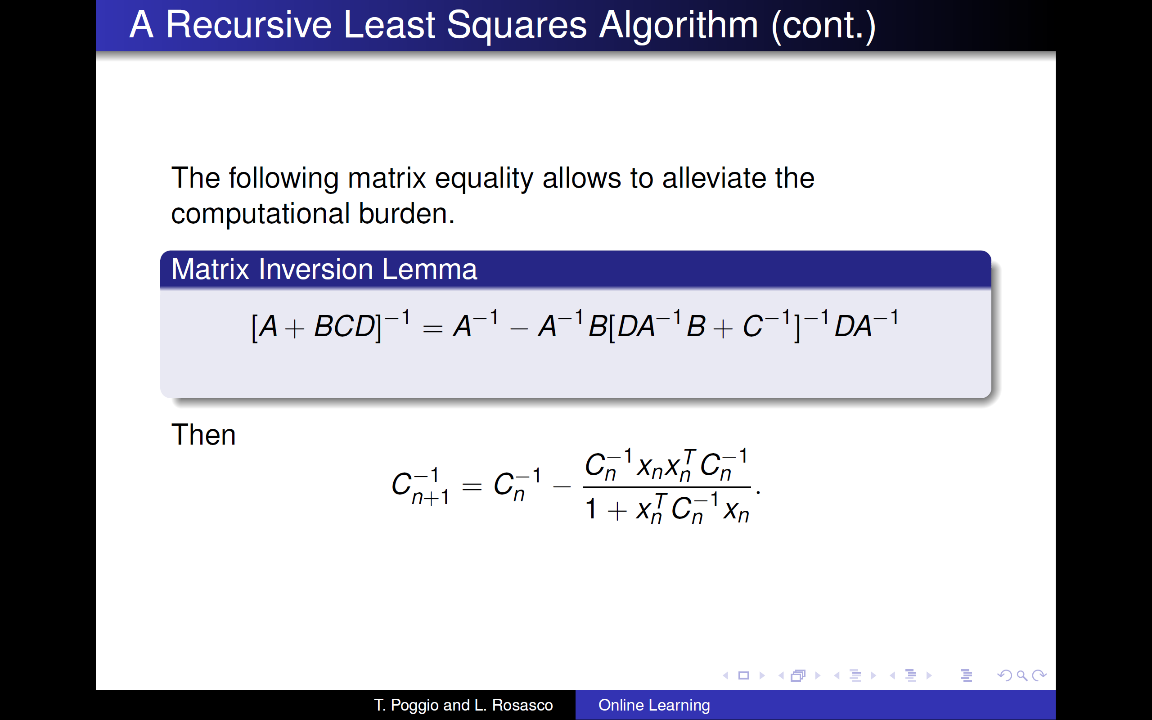

Slide 18
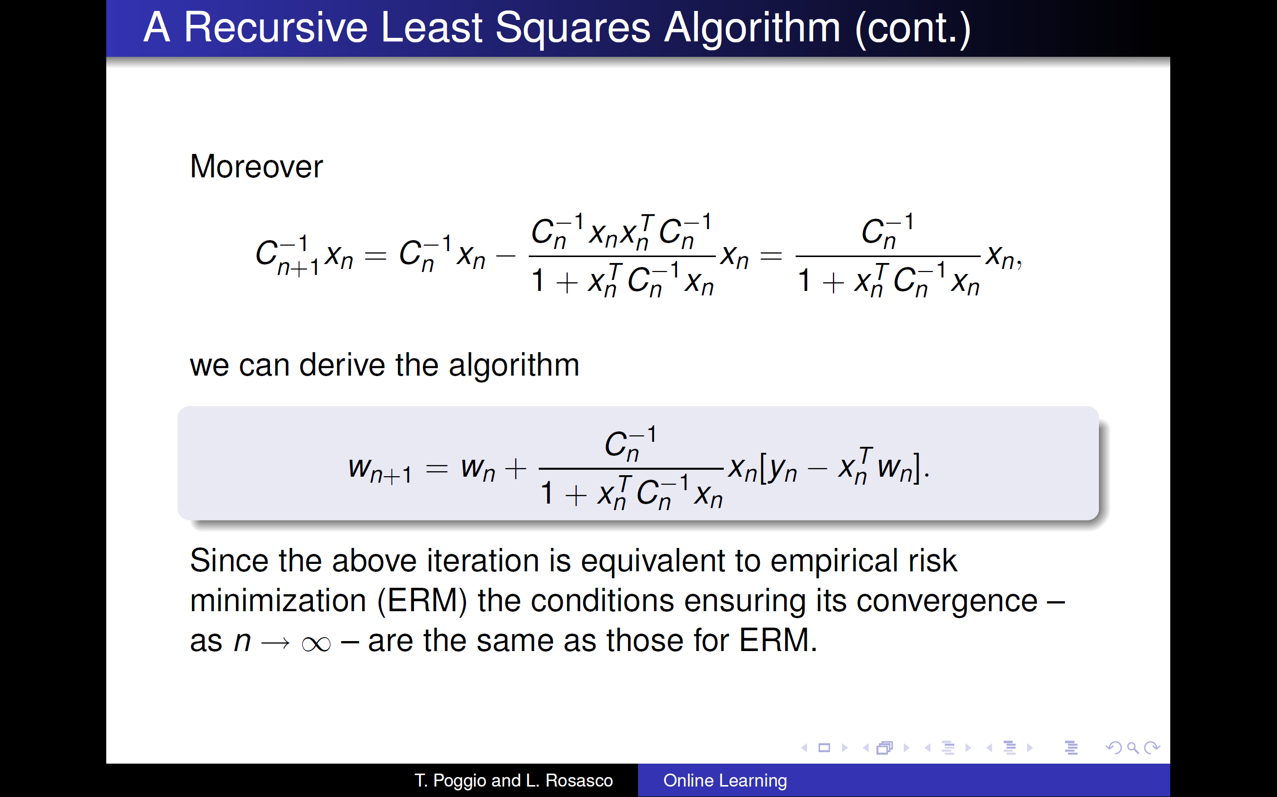

Slide 19
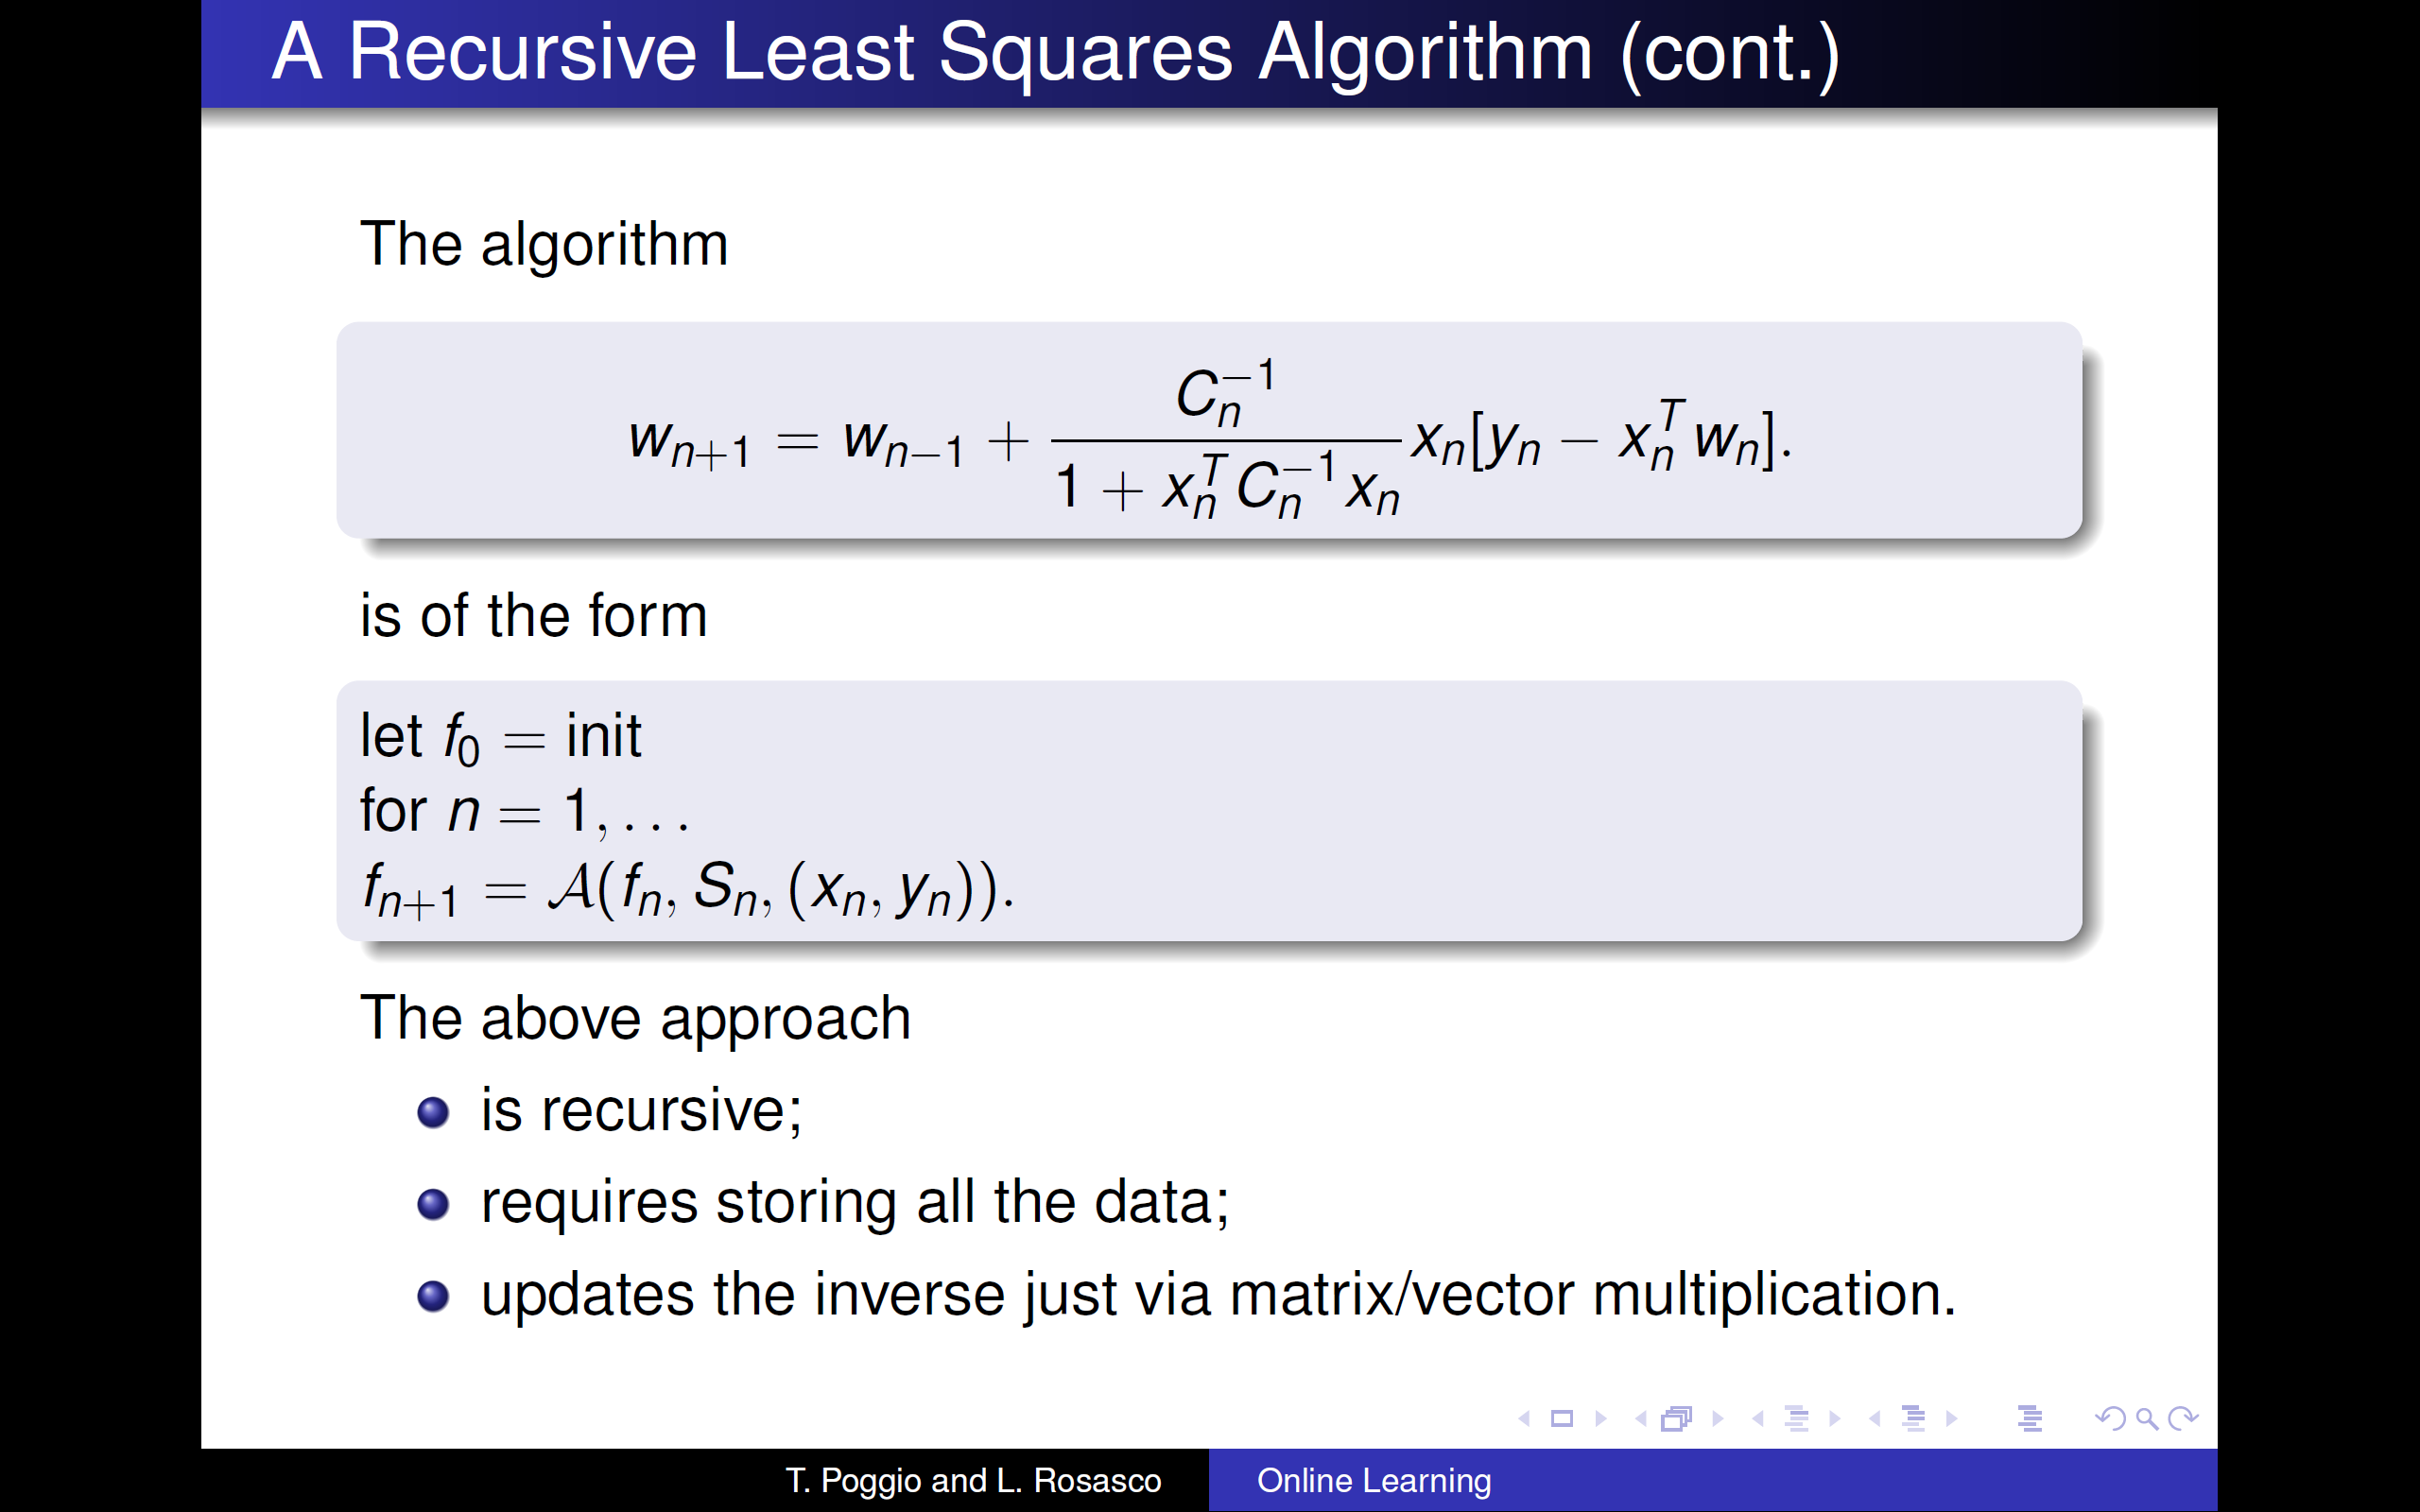

Slide 20
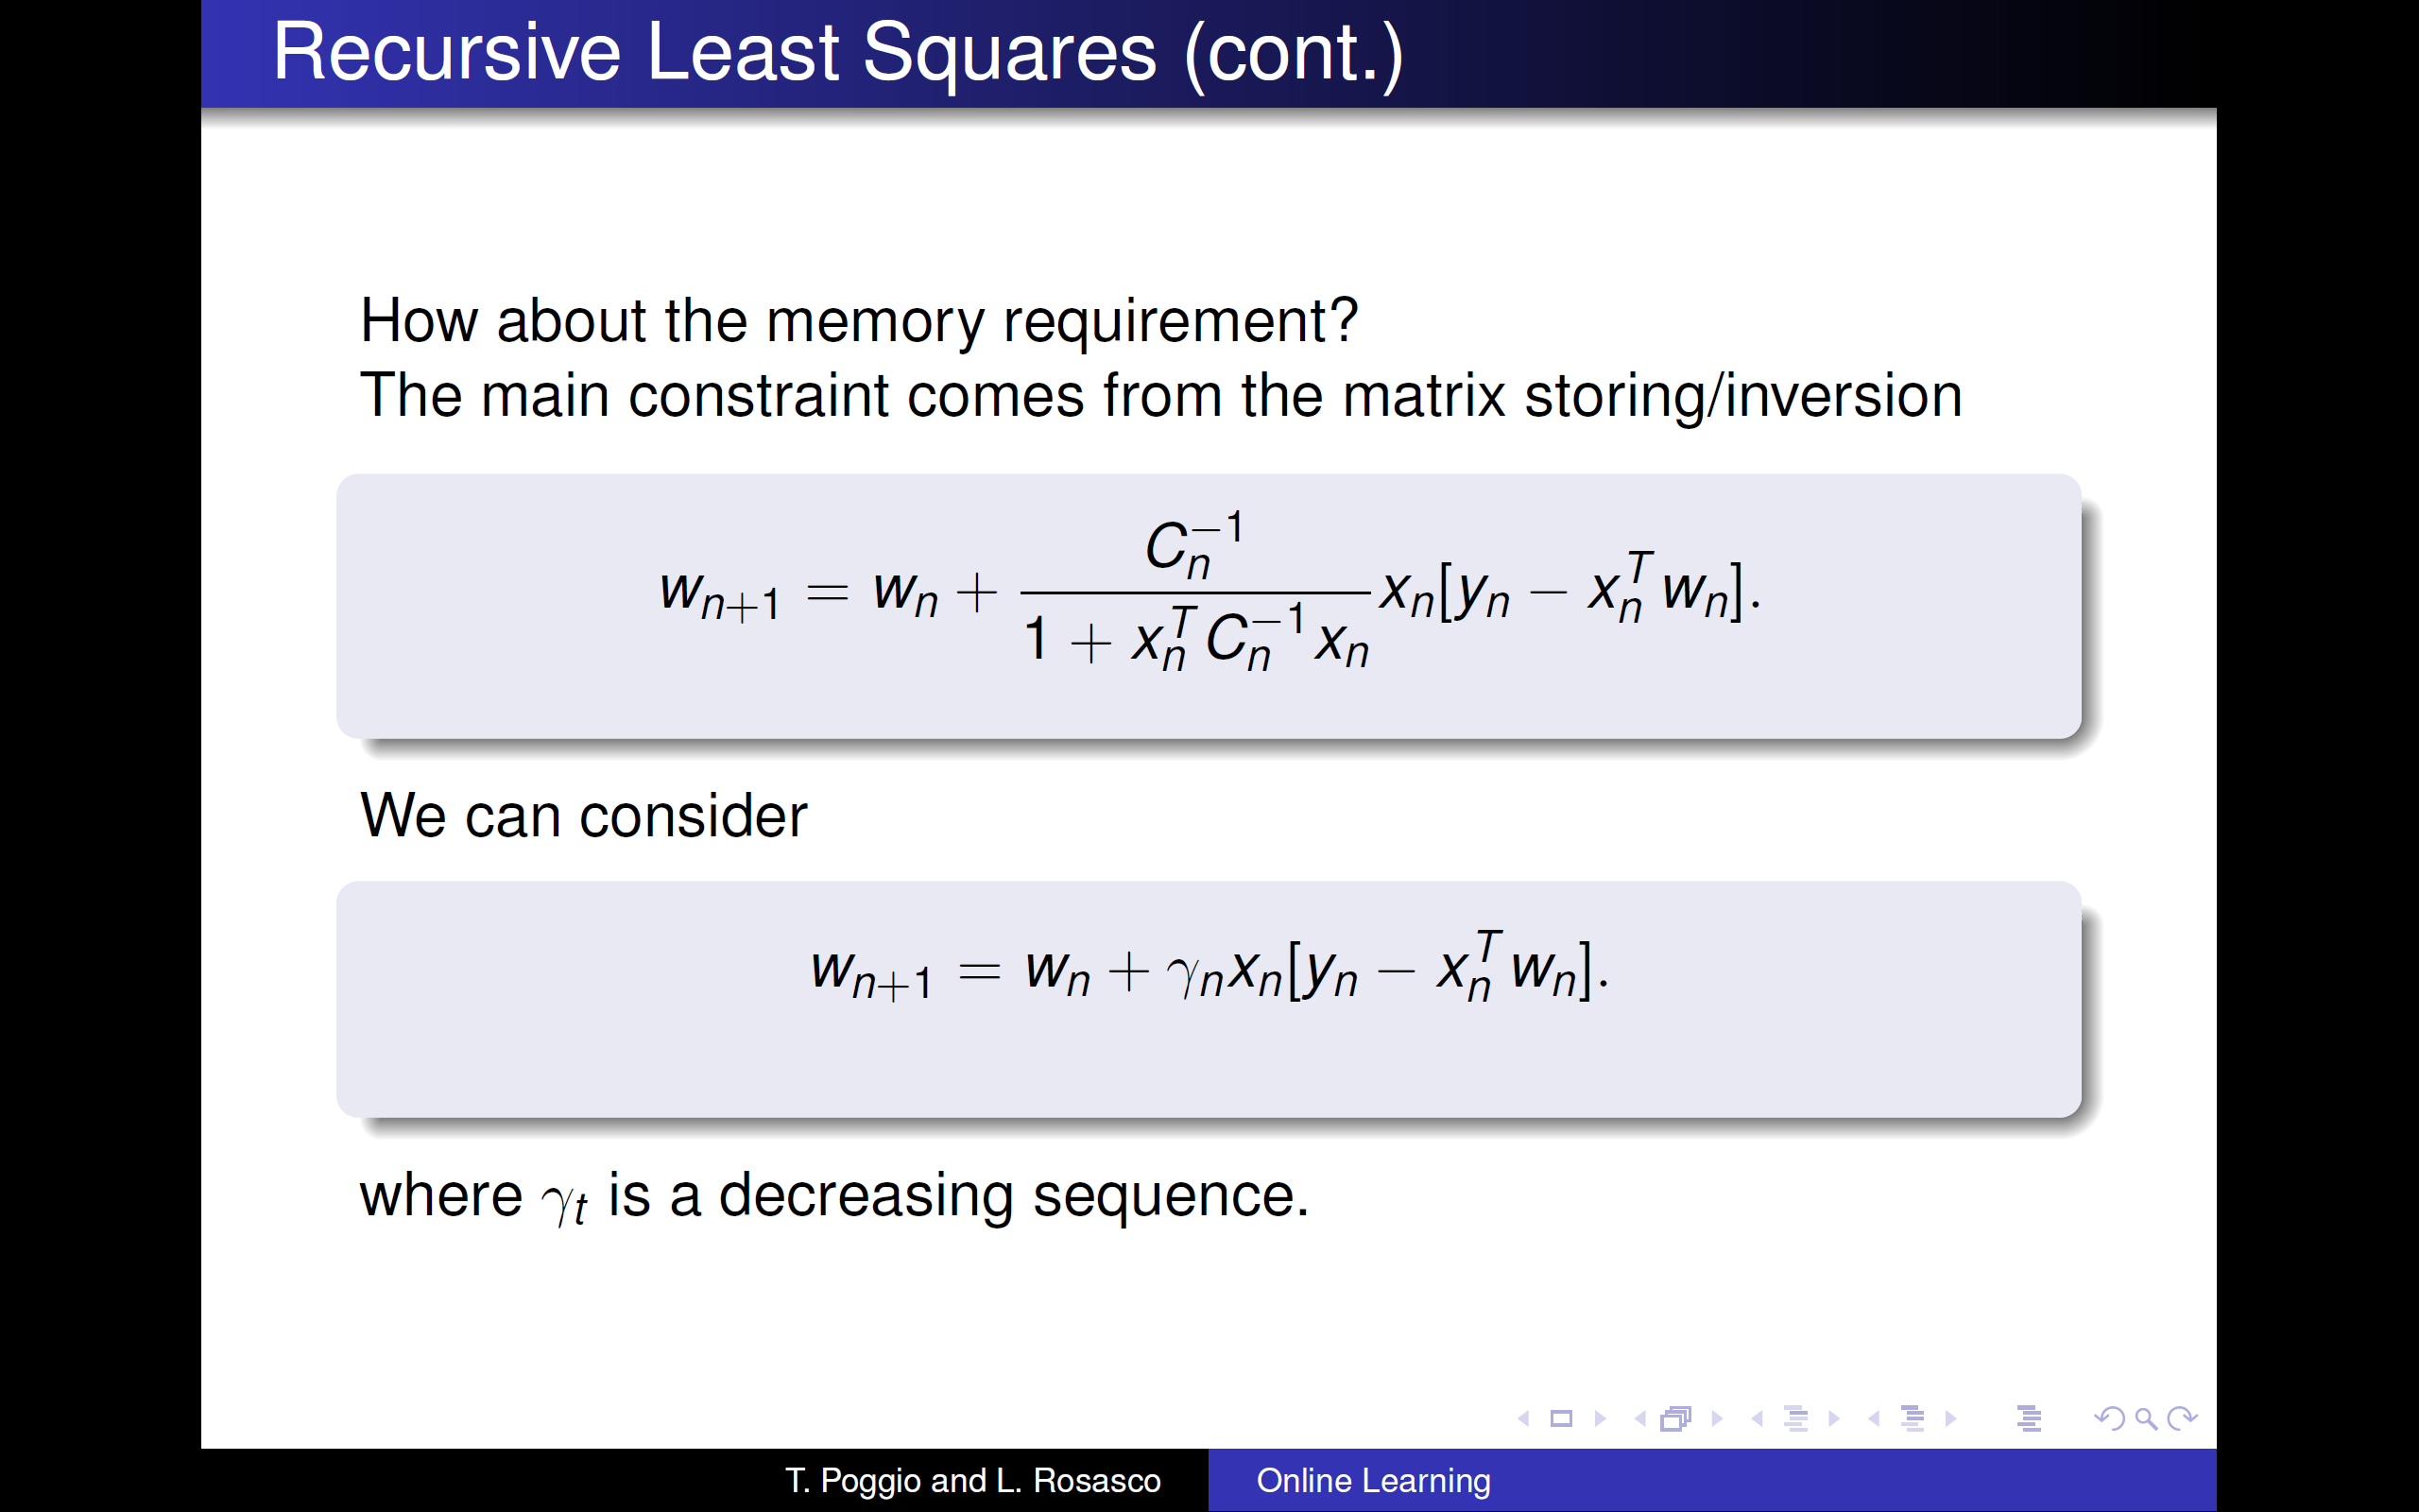

Slide 21
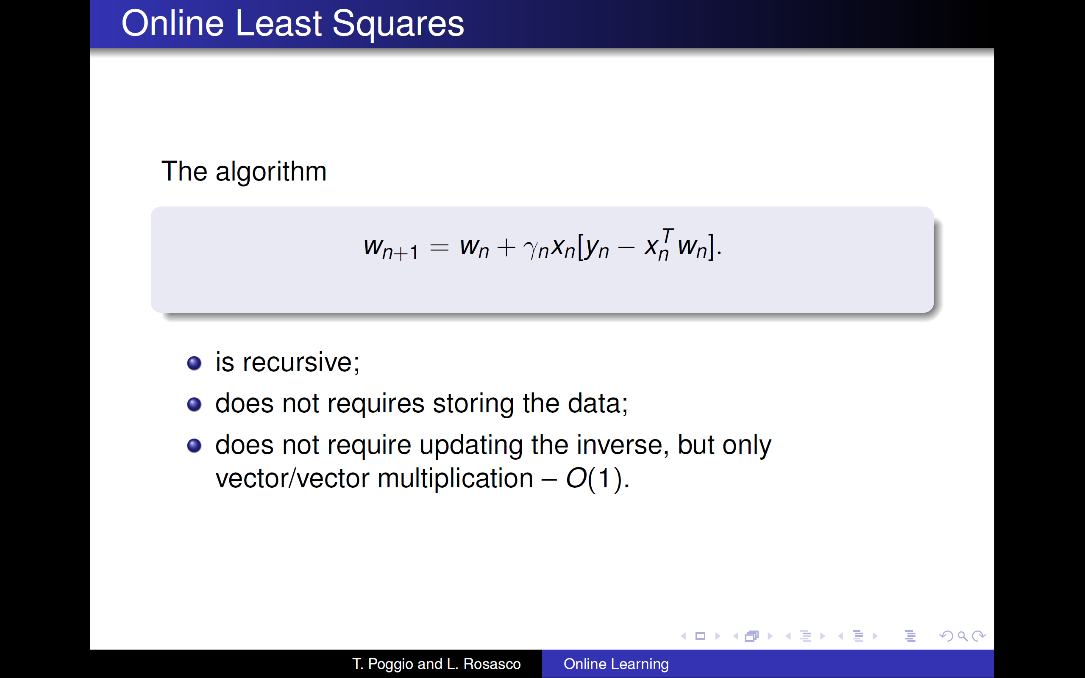

Slide 22
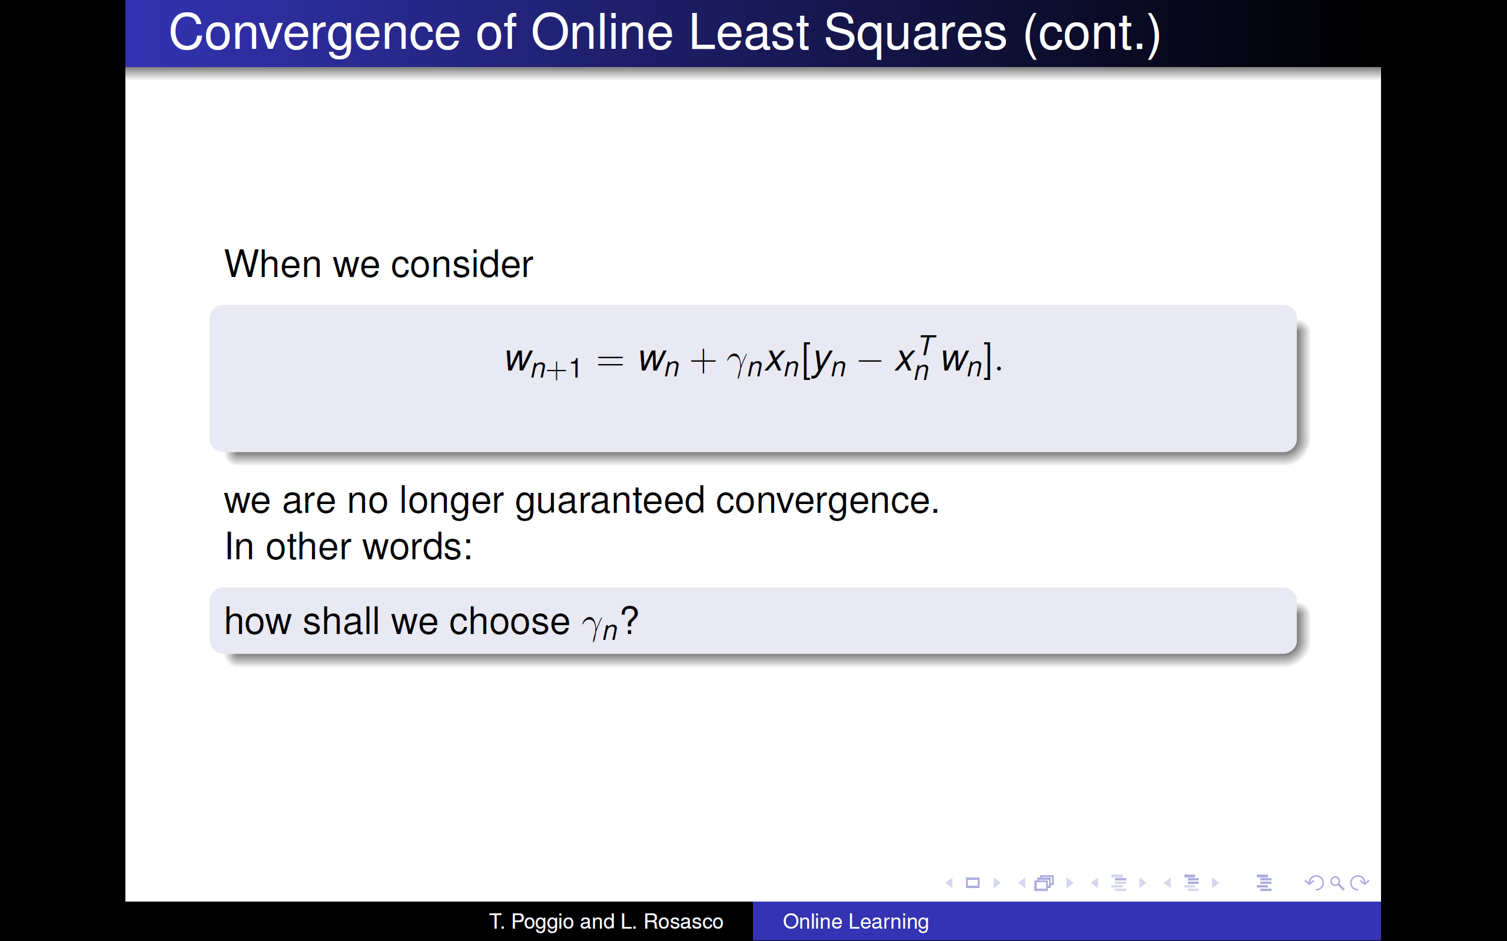

Slide 23
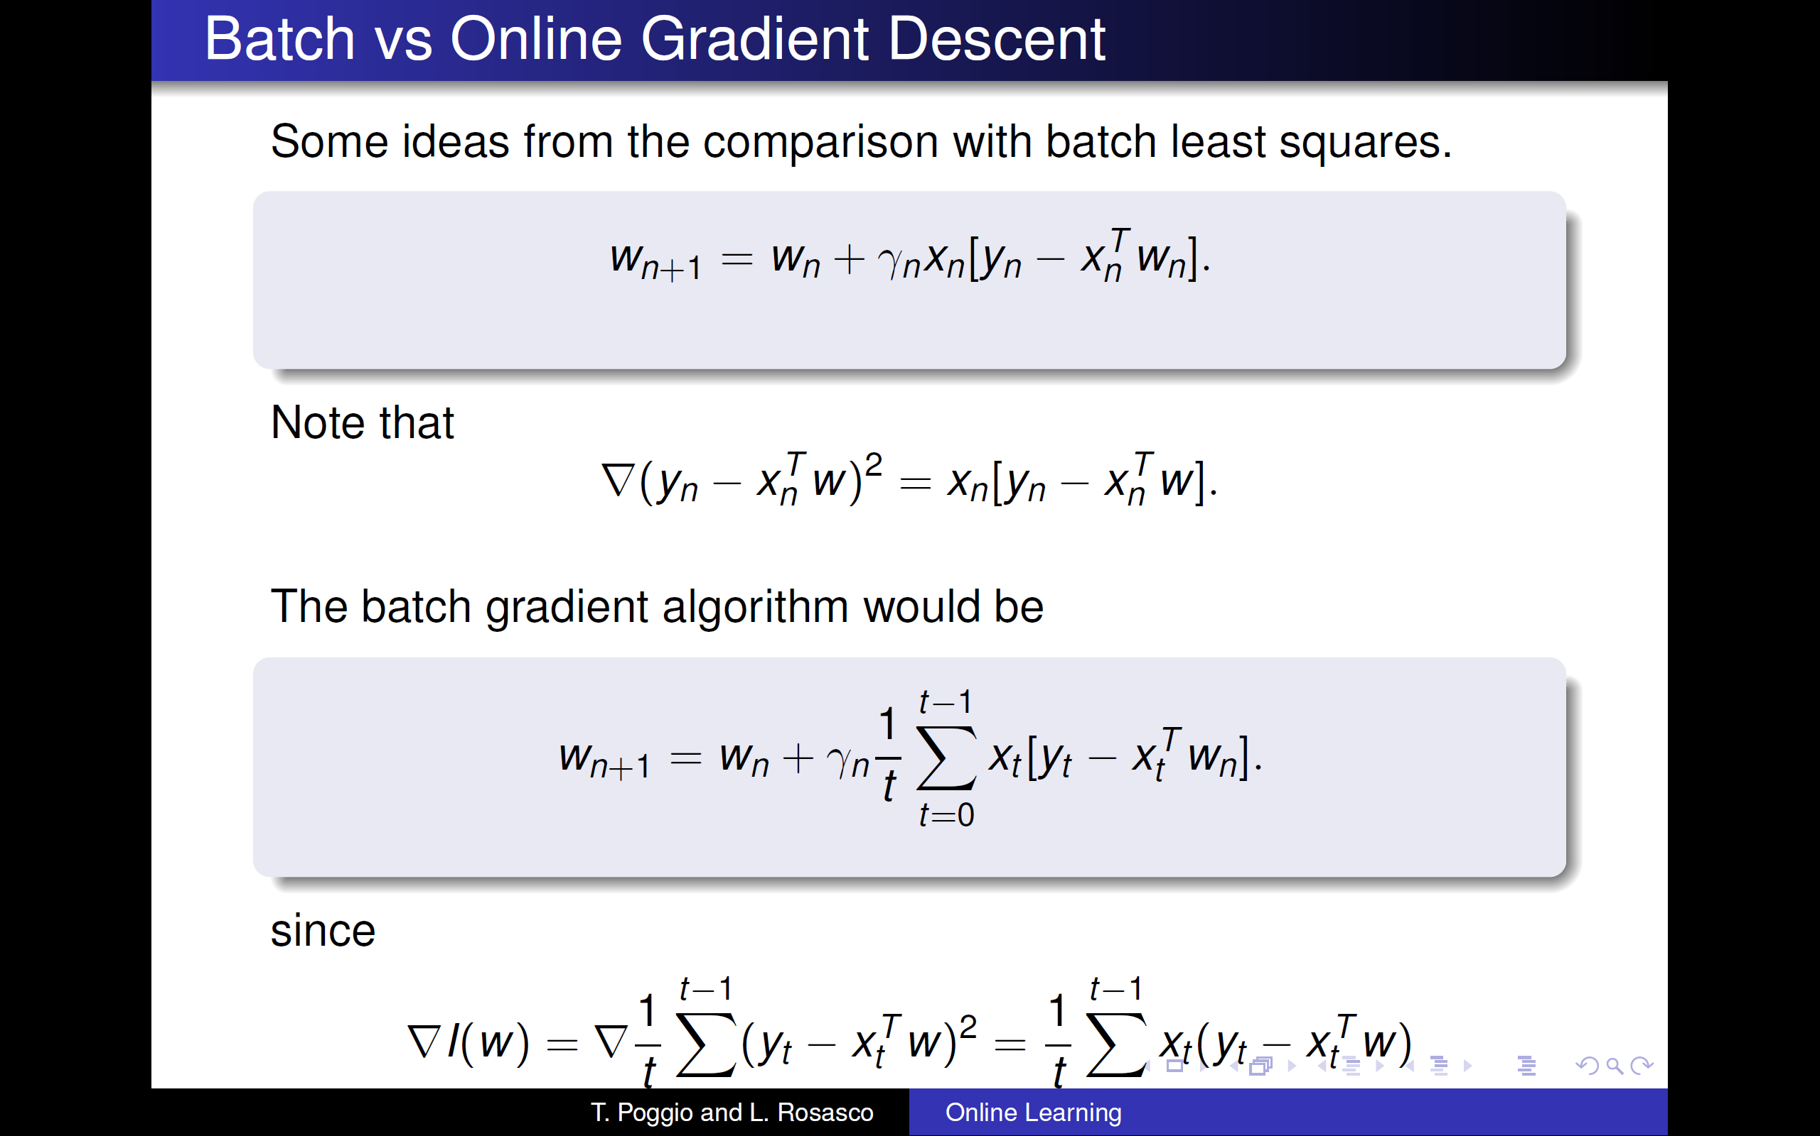

Slide 24
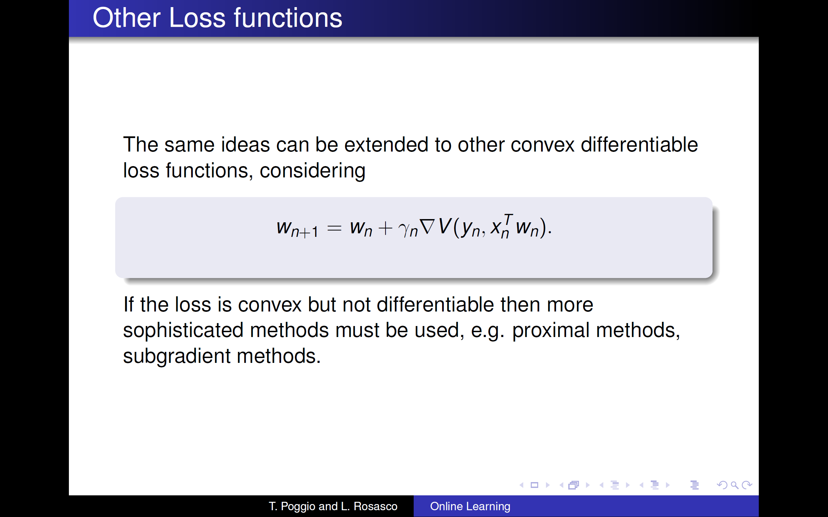

Slide 25
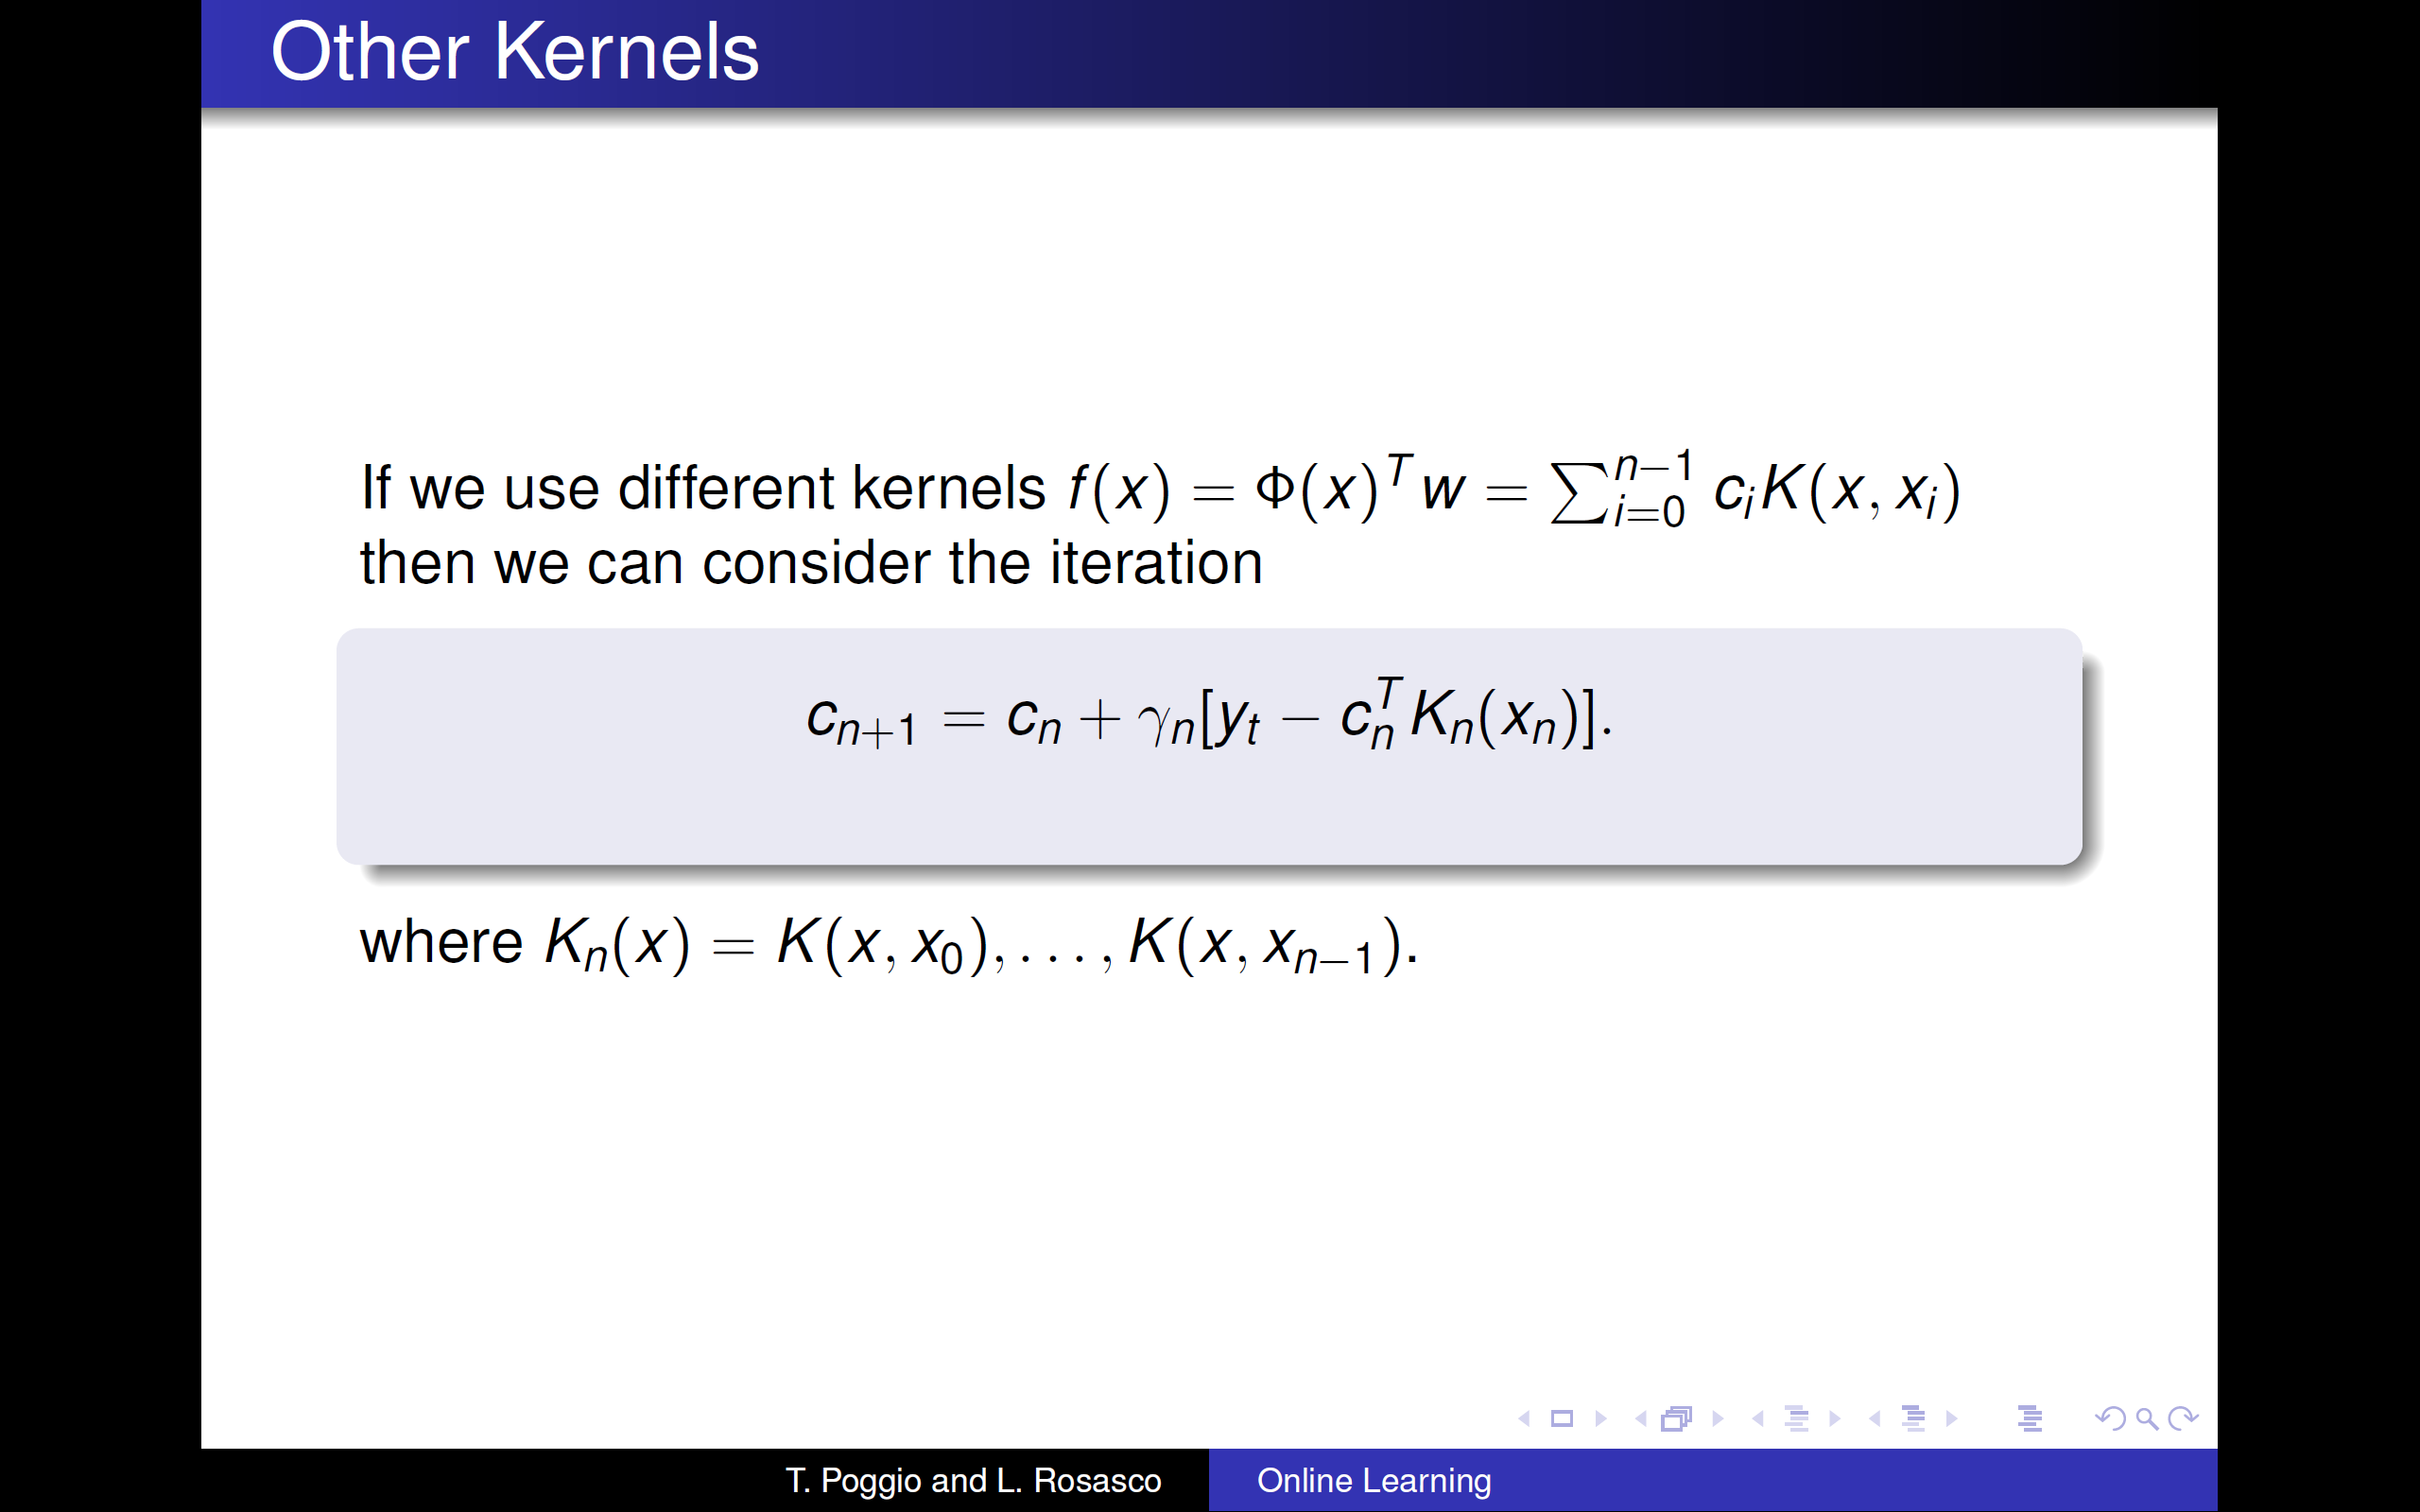

Slide 26
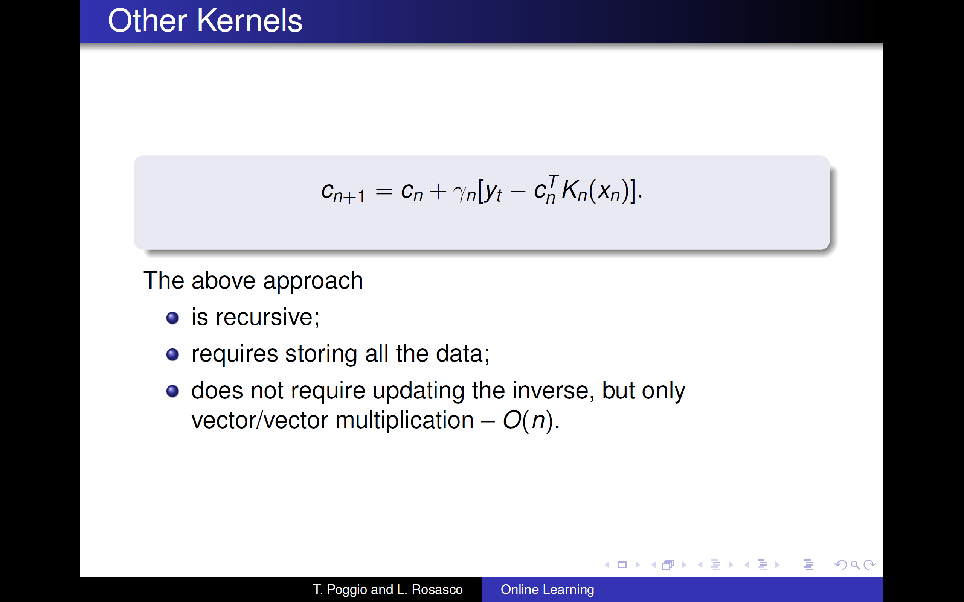

Slide 27
Supervised learning
Adversarial models (game Theory)
Statistical models
Batch learning
Online learning
SVM
GD
SGD
IGD
FTL
FTRL
OGD
OMD

Slide 28
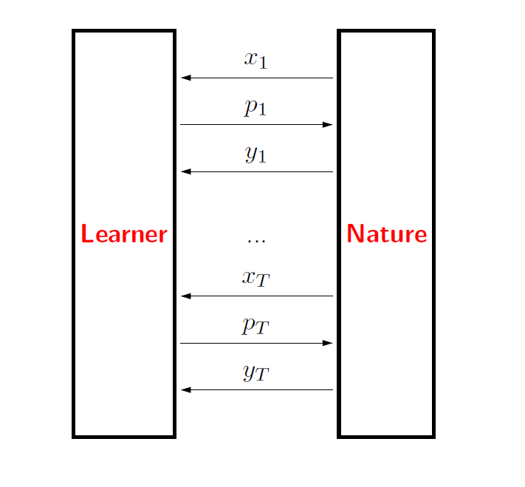


Adversarial sequential learning
Game between learner and Nature

Slide 29
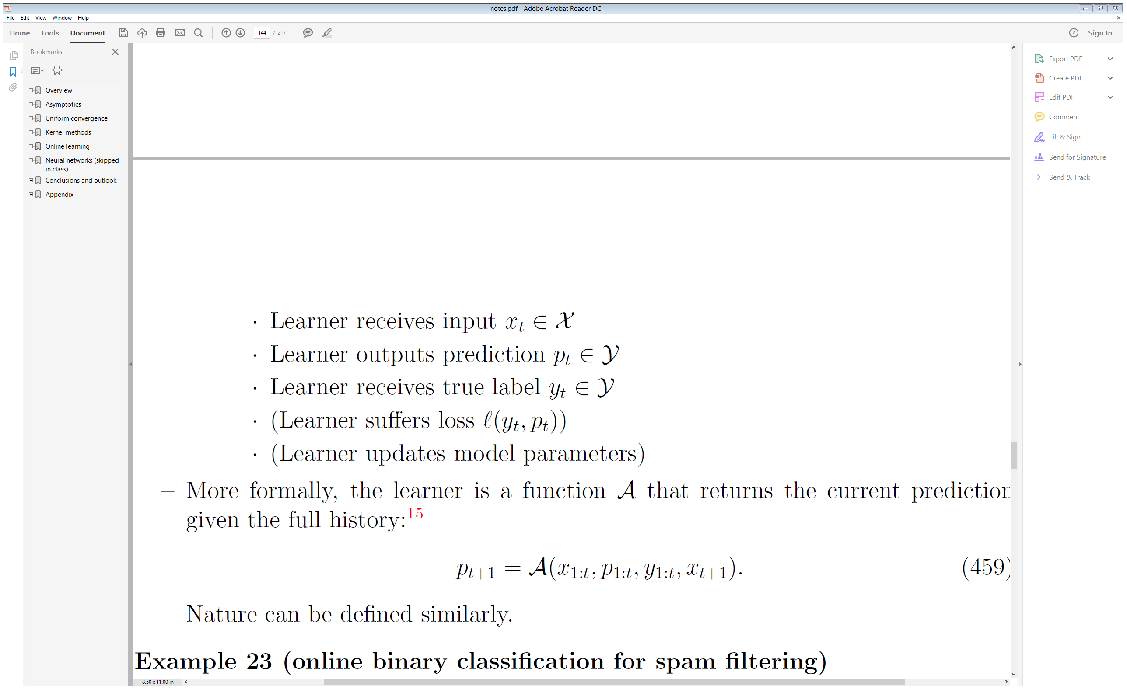
Online Learning Game
For t = 1,….,T
Stanford CS229T/STAT231: Statistical Learning Theory notes [Dr. John Duchi,2016]

Slide 30
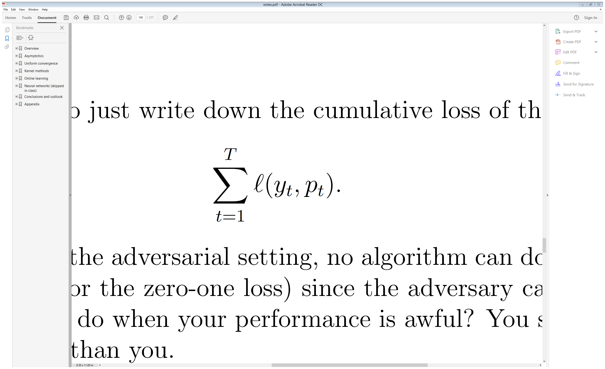
Online Learning Game
What if learner predictions are all wrong? ( Nature knows your moves beforehand !!)
Stanford CS229T/STAT231: Statistical Learning Theory notes [Dr. John Duchi,2016]

Slide 31

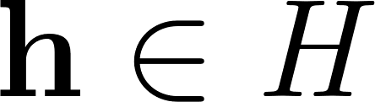
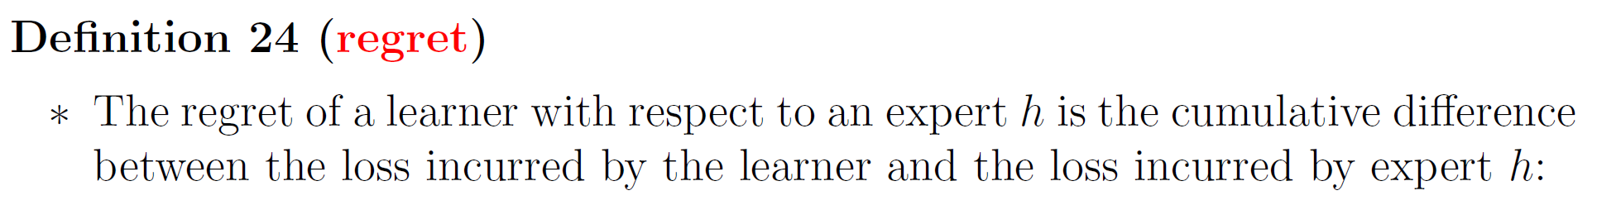
Online Learning Game
Expert:
Unlike learner , expert doesn’t adapt with time
Stanford CS229T/STAT231: Statistical Learning Theory notes [Dr. John Duchi,2016]

Slide 32
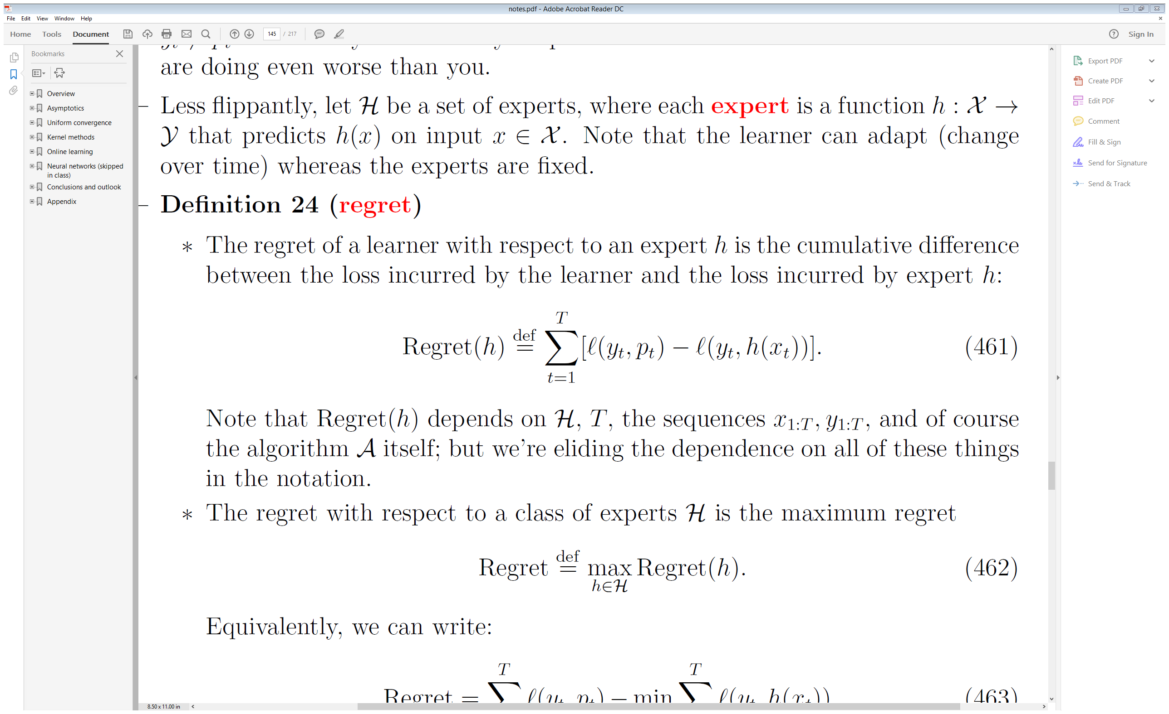
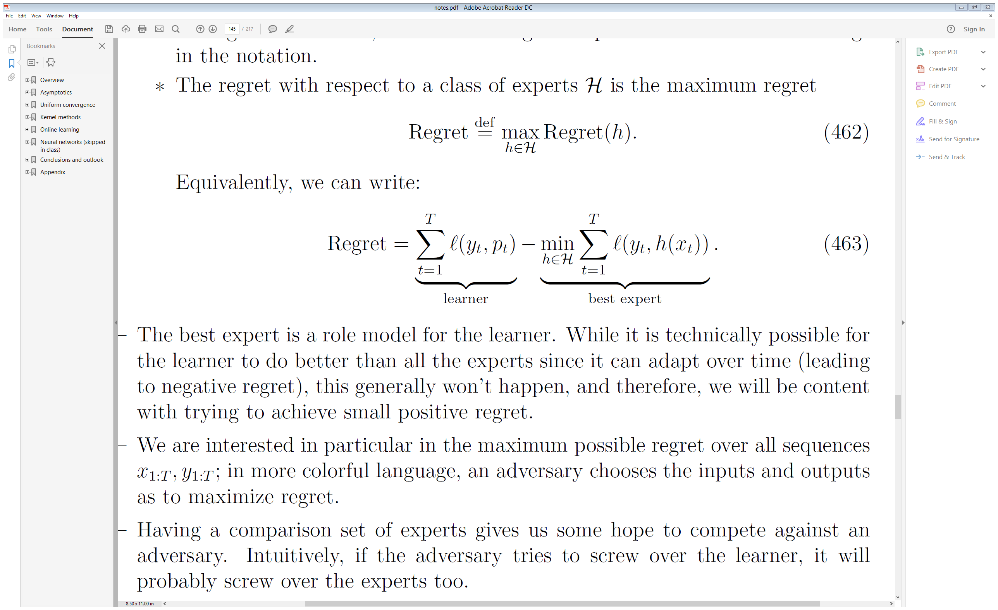
Online Learning Game
Stanford CS229T/STAT231: Statistical Learning Theory notes [Dr. John Duchi,2016]

Slide 33
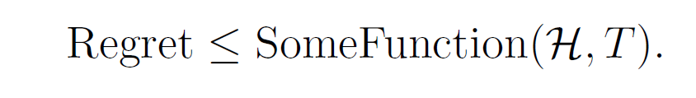
Online Learning Game
The expert is the role model for the learner
(be an expert , don’t try to beat nature)
The goal is to bound Regret
A sublinear function of T is enough to insure zero regret as T -> ∞
Stanford CS229T/STAT231: Statistical Learning Theory notes [Dr. John Duchi,2016]

Slide 34
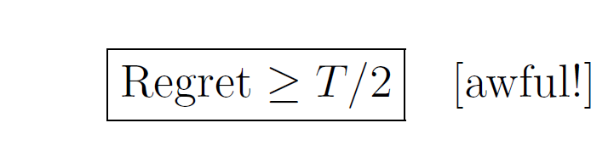
Some examples
Binary classification with zero-one loss :
Stanford CS229T/STAT231: Statistical Learning Theory notes [Dr. John Duchi,2016]

Slide 35
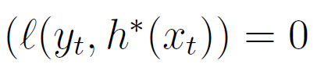
Online Learning Game
Realisablity : Perfect Expert Exists in H
Regret =
Stanford CS229T/STAT231: Statistical Learning Theory notes [Dr. John Duchi,2016]

Slide 36
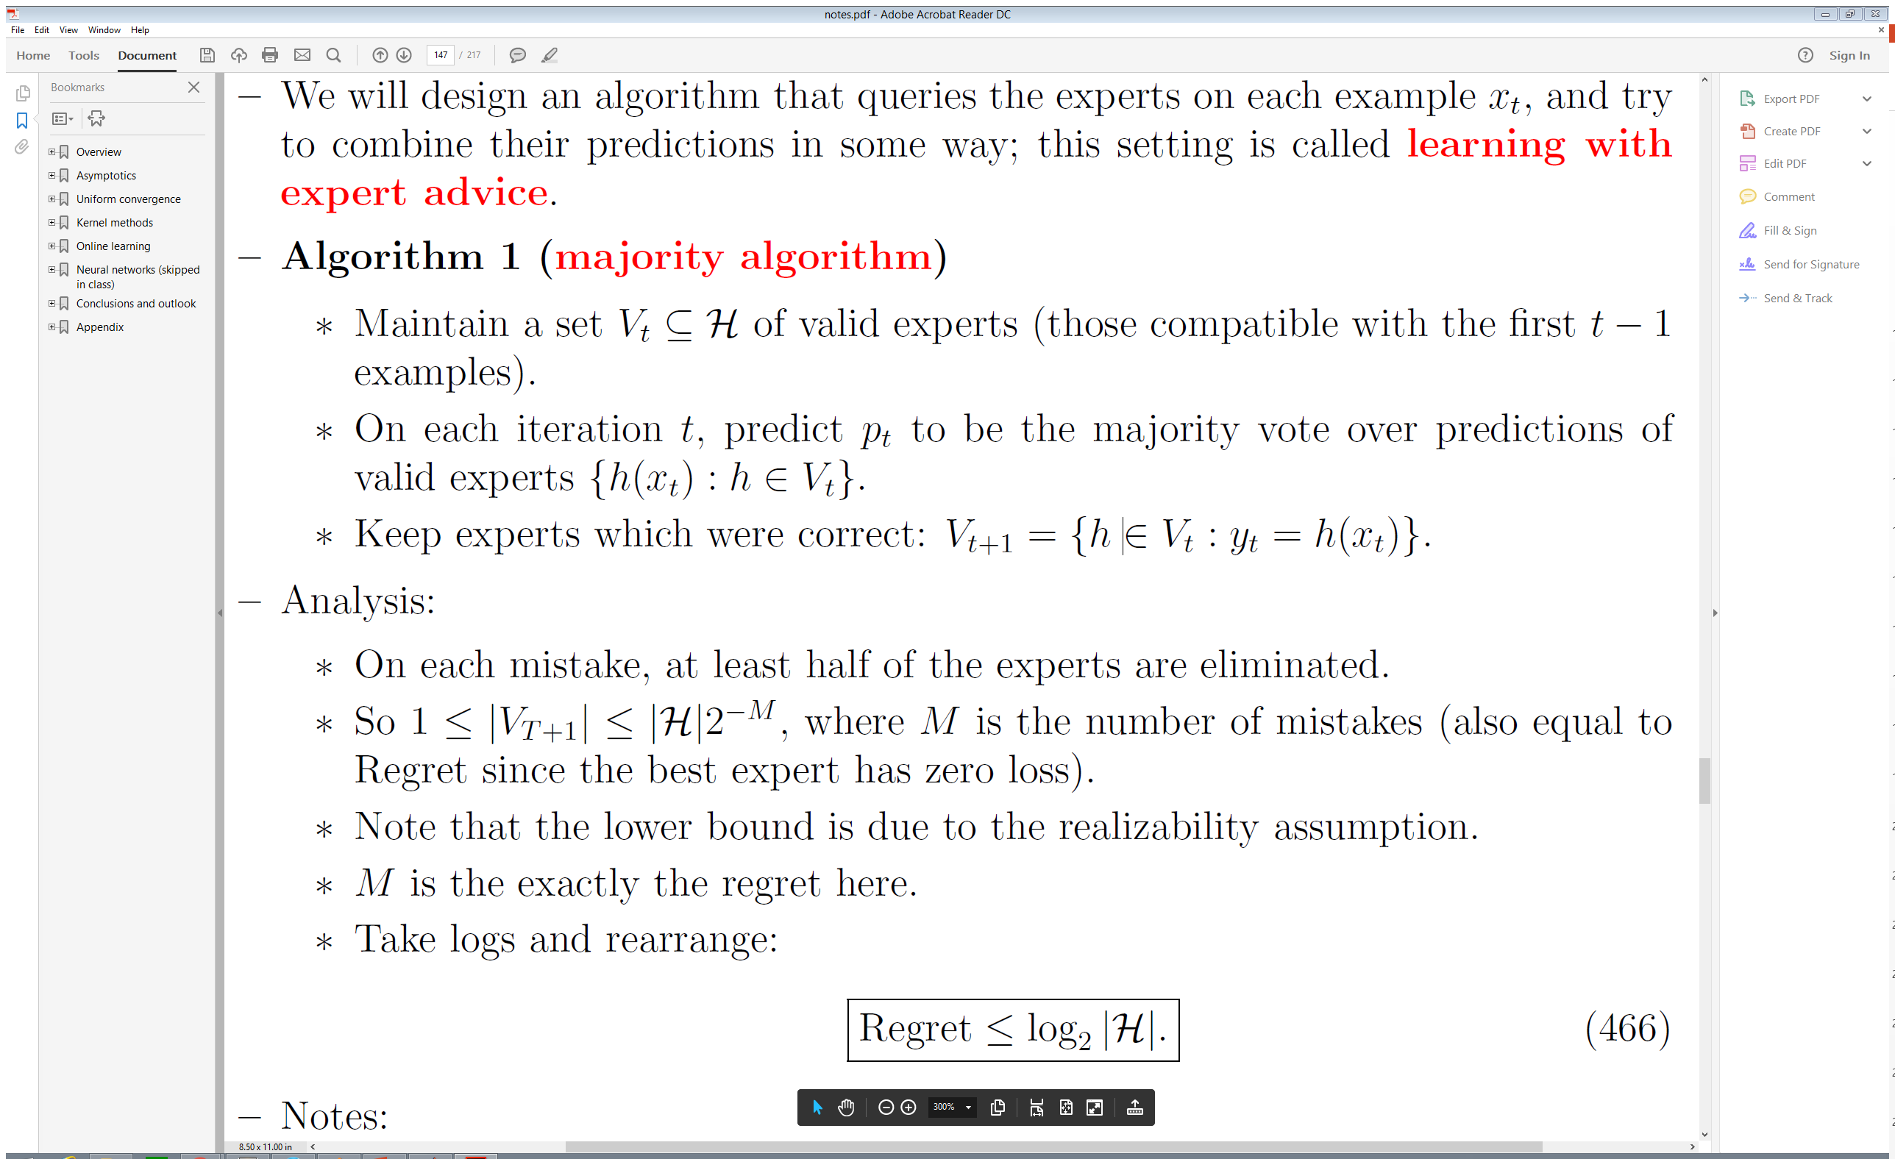
Some examples: Learning with expert advice
Binary classification with zero one loss :
Stanford CS229T/STAT231: Statistical Learning Theory notes [Dr. John Duchi,2016]

Slide 37
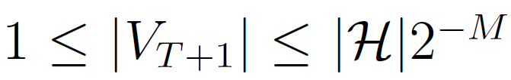
Some examples: Learning with expert advice
Regret = = M
Stanford CS229T/STAT231: Statistical Learning Theory notes [Dr. John Duchi,2016]

Slide 38
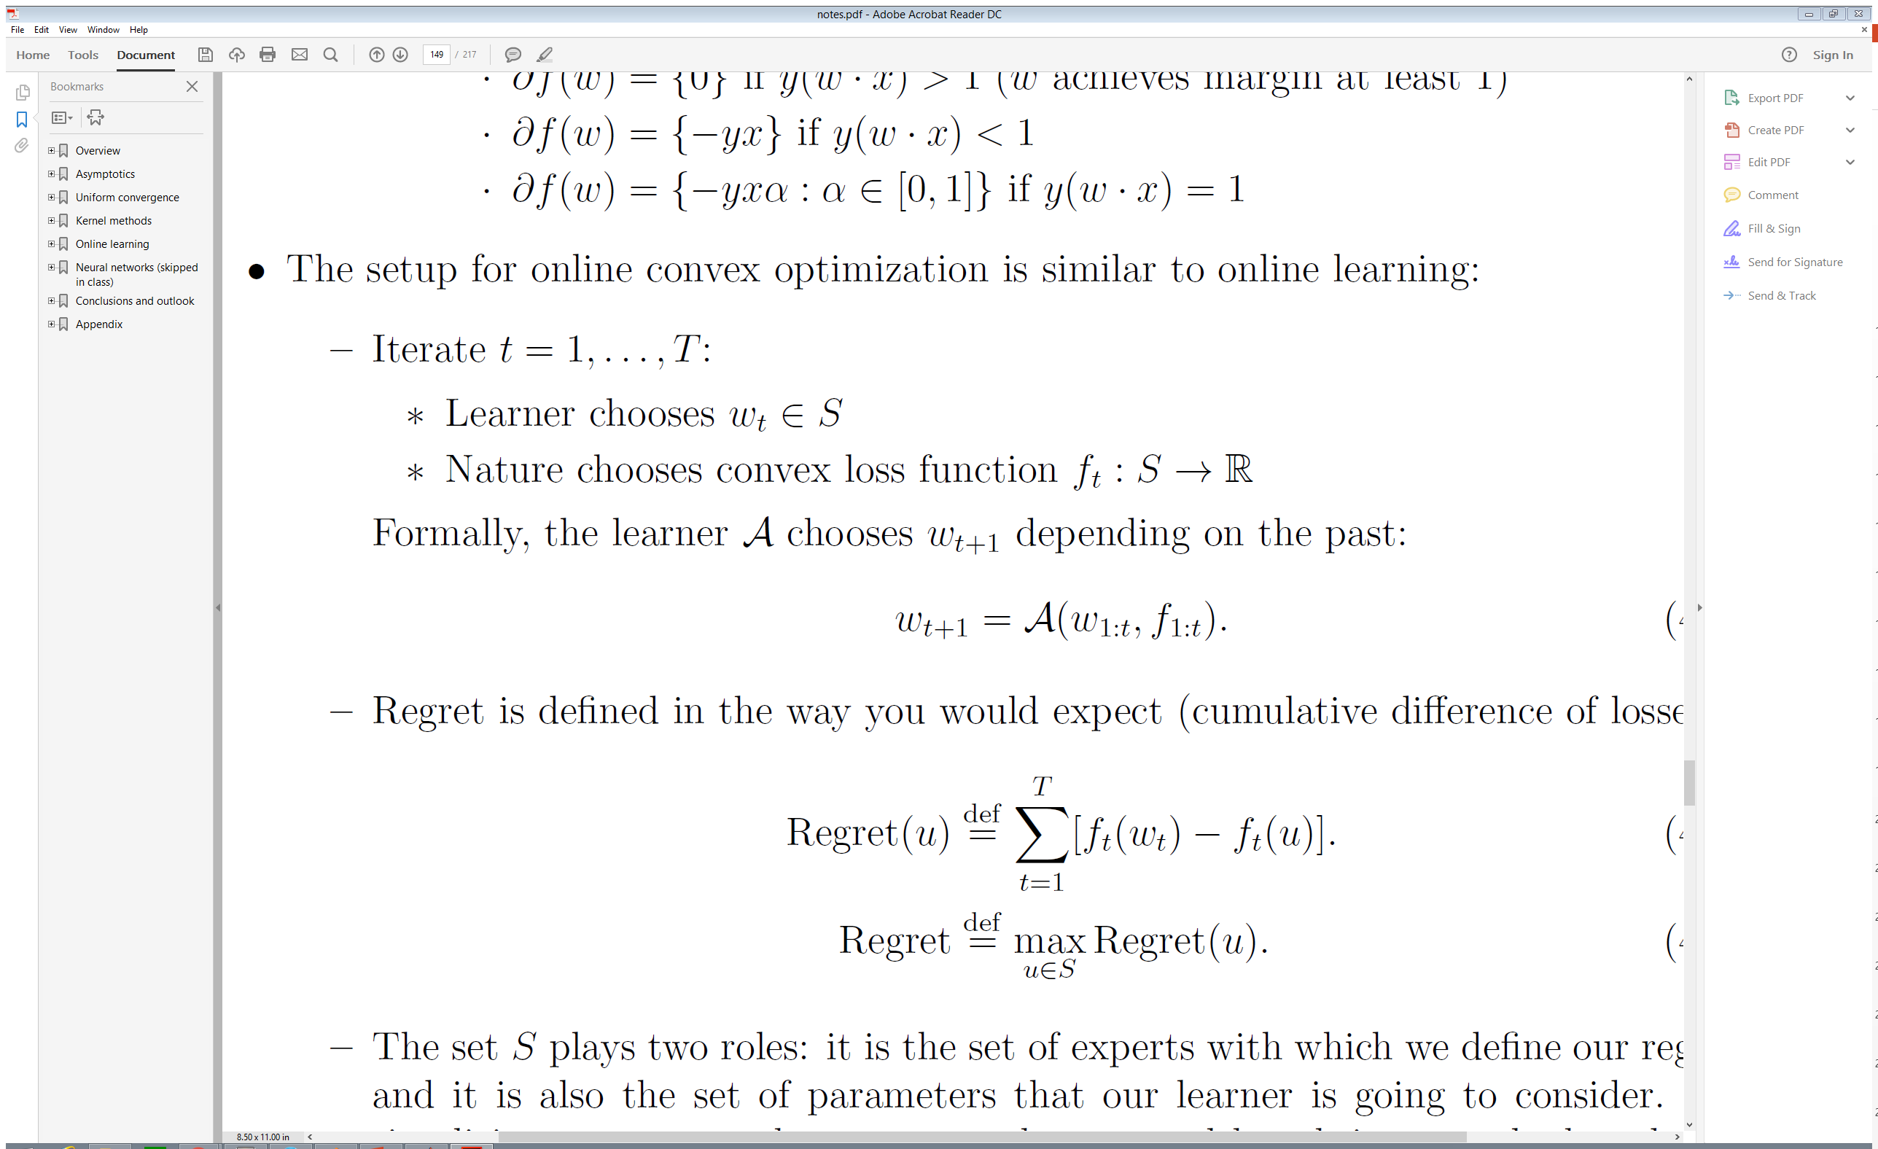
Online Convex Optimization
“Stanford CS229T/STAT231: Statistical Learning Theory ” [Dr. John Duchi,2016]

Slide 39
From OL to OCO
Randomization
Surrogate Loss
“Stanford CS229T/STAT231: Statistical Learning Theory ” [Dr. John Duchi,2016]

Slide 40
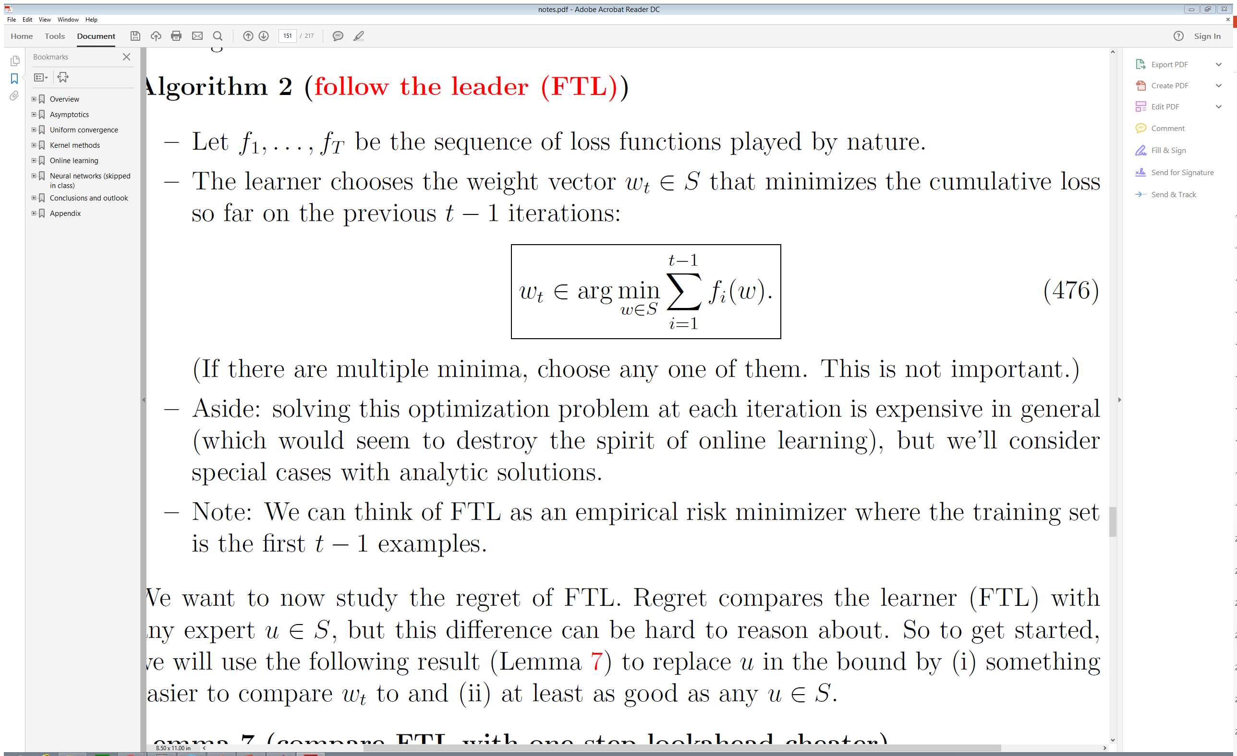
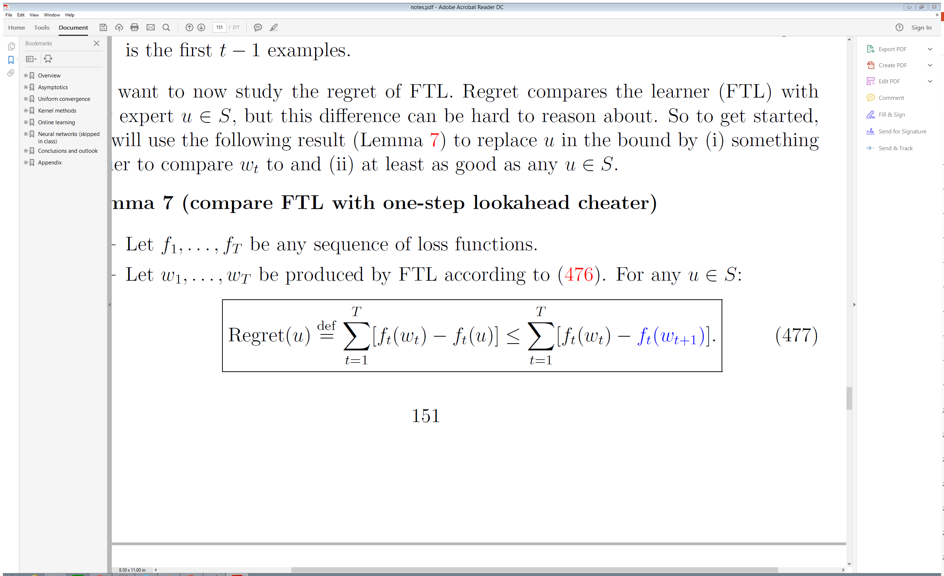
Follow The Leader ( FTL)
“Stanford CS229T/STAT231: Statistical Learning Theory ” [Dr. John Duchi,2016]

Slide 41
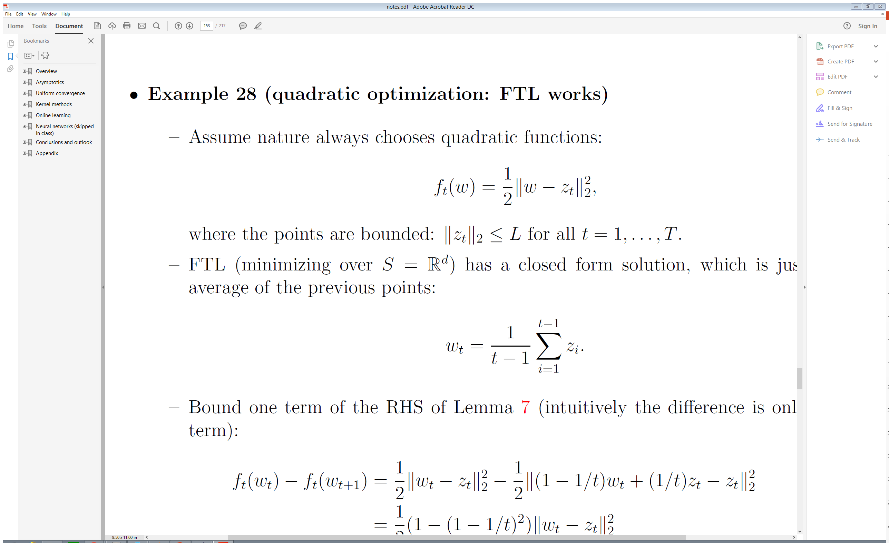
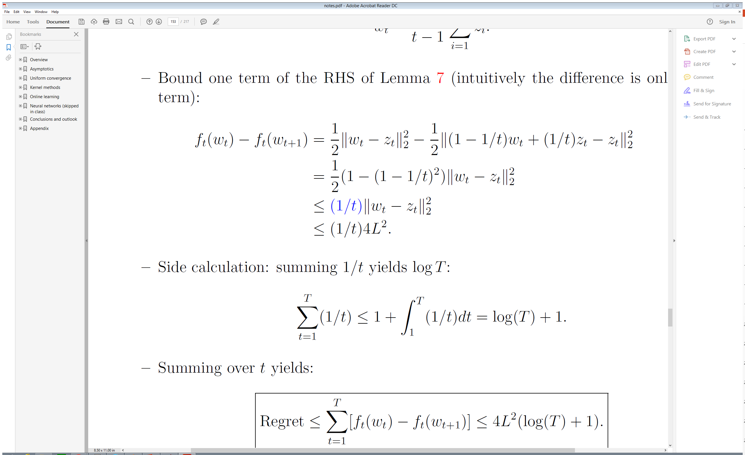
Follow The Leader ( FTL)
Stanford CS229T/STAT231: Statistical Learning Theory notes [Dr. John Duchi,2016]

Slide 42
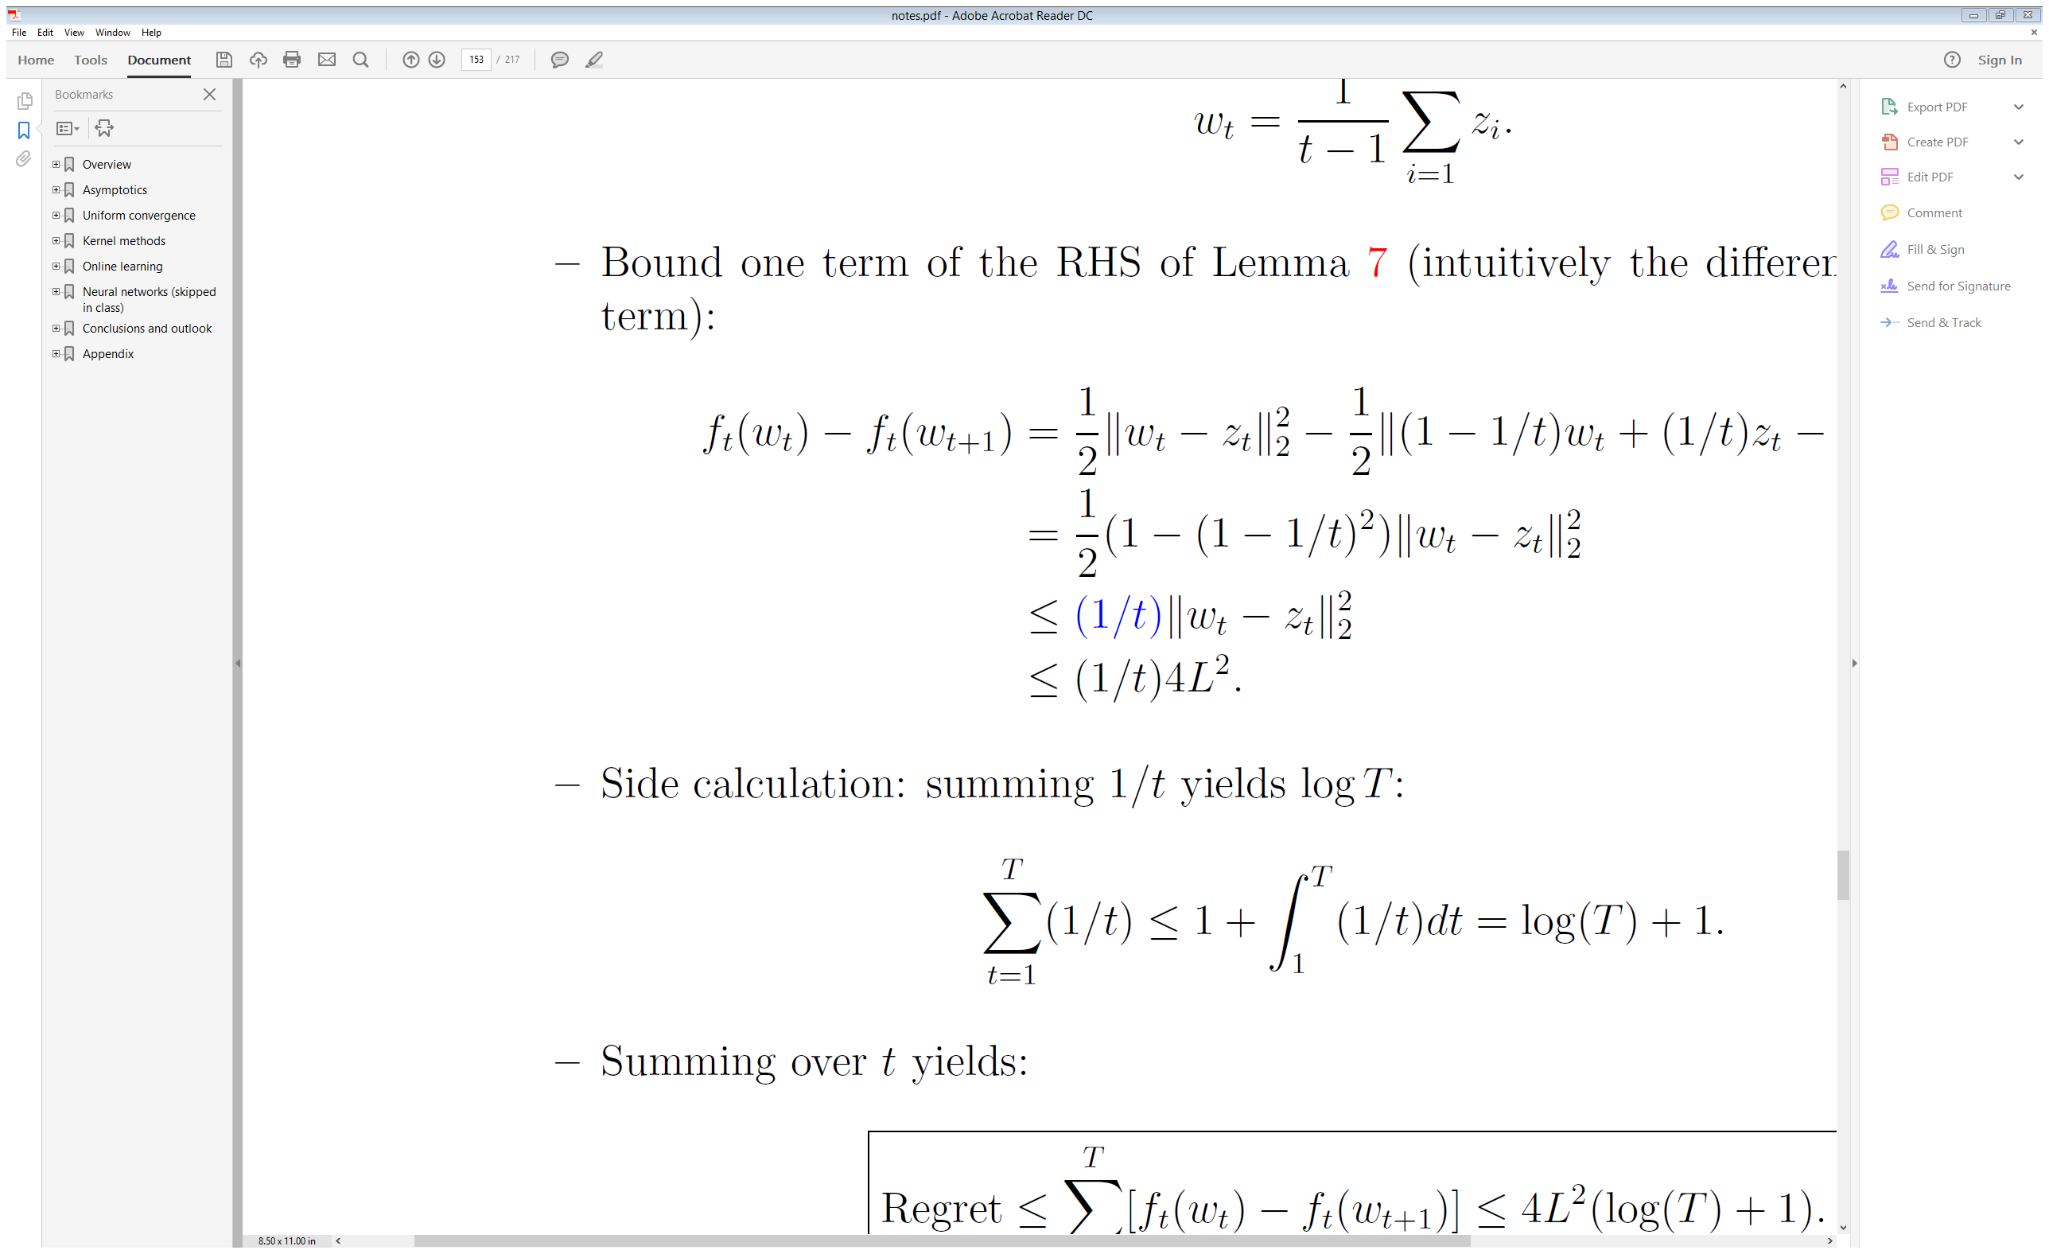
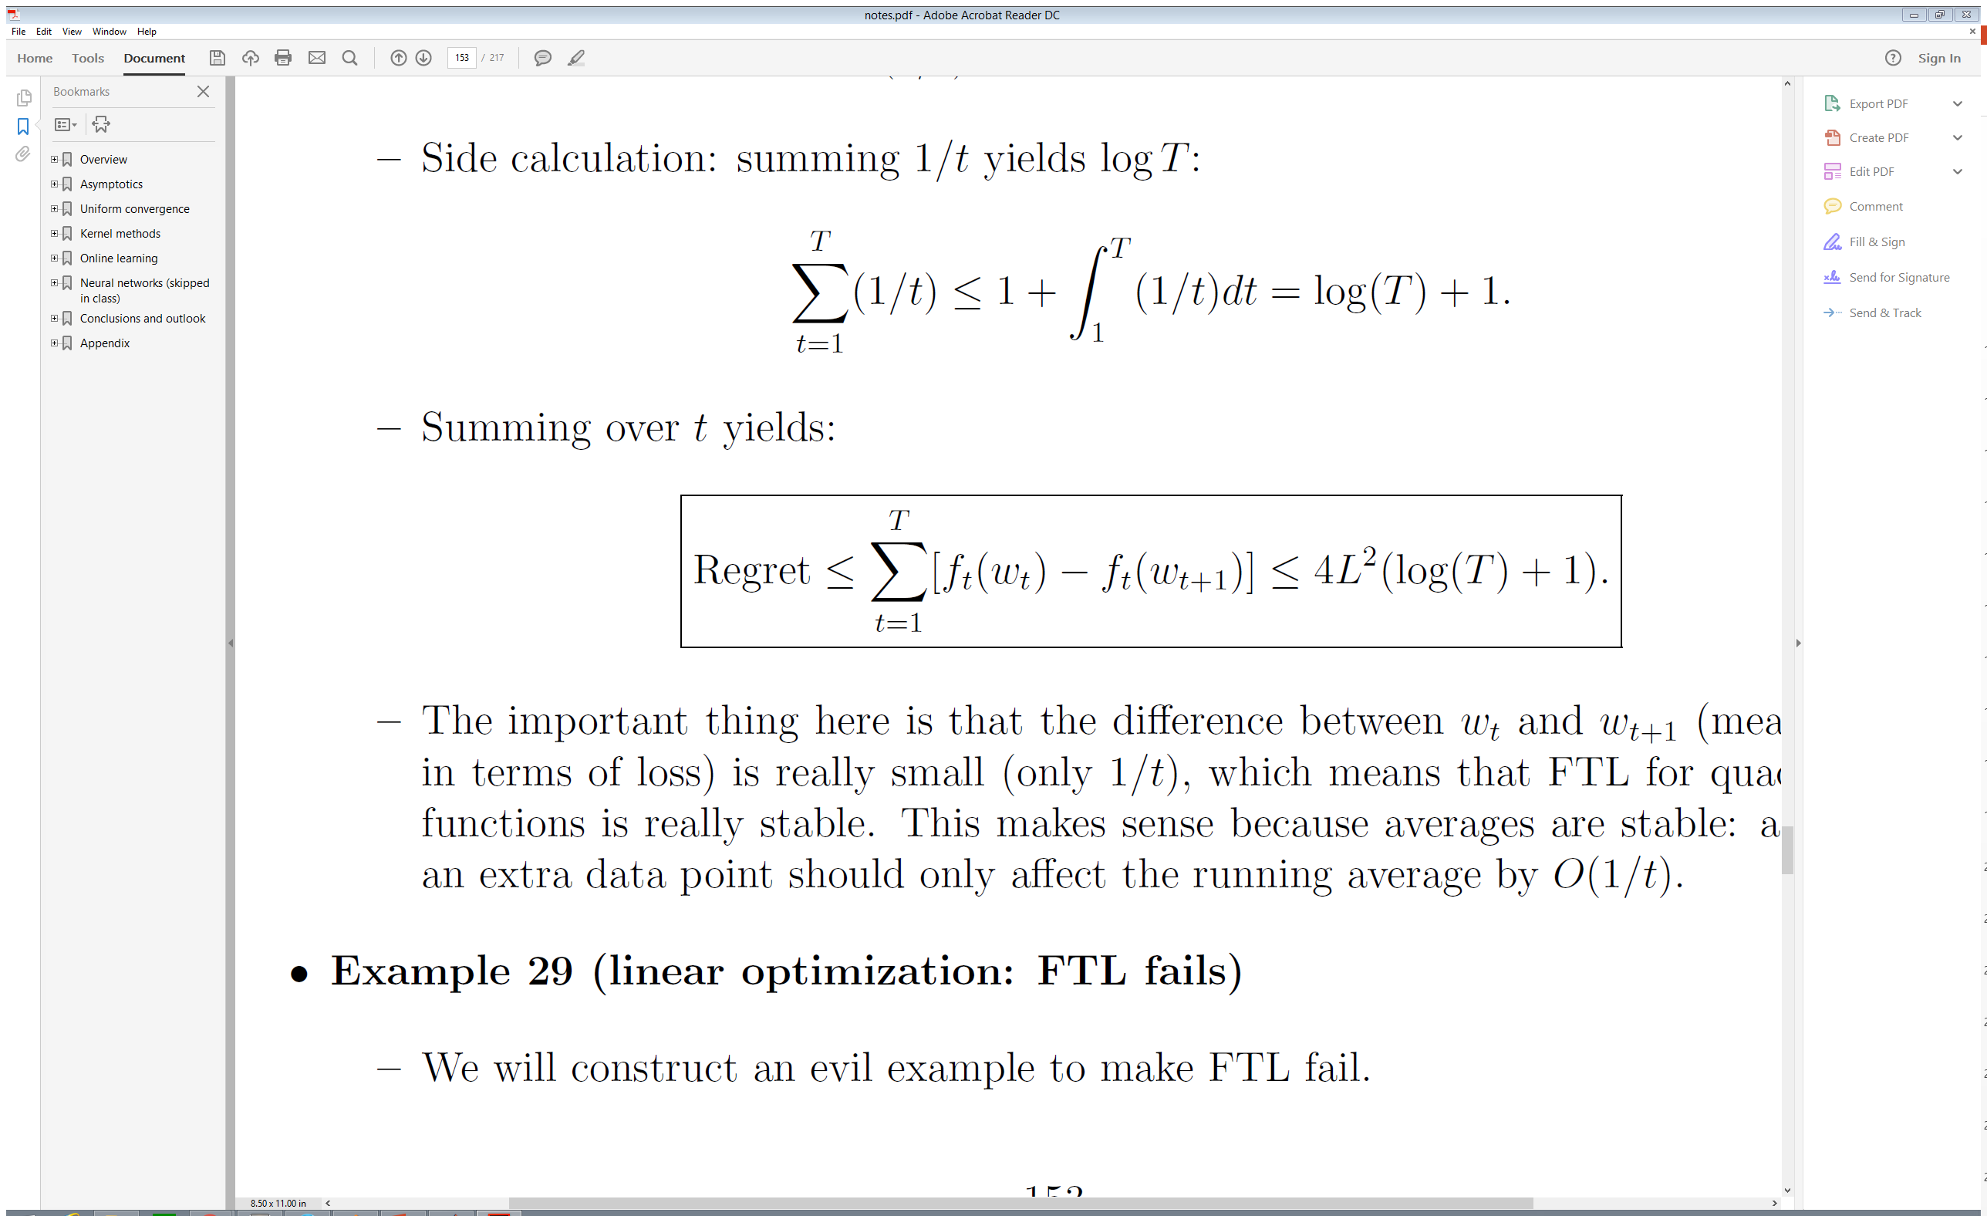
Follow The Leader ( FTL)
Stanford CS229T/STAT231: Statistical Learning Theory notes [Dr. John Duchi,2016]

Slide 43
Online Learning Game
The expert is the role model for the learner
(be an expert , don’t try to beat nature)
The goal is to bound Regret
A sublinear function of T is enough to insure zero regret as T -> ∞
Stanford CS229T/STAT231: Statistical Learning Theory notes [Dr. John Duchi,2016]

Slide 44
Key Points
Off-line learning | online learning
Fixed Training set | Stream of data
Modeling static mapping | Can be dynamic mapping
Minimizing Loss function | Bounding Regret
Slow training | Fast training /testing
Iid samples assumption | Can be dependent sample
Statistical models | Game Theory

Slide 45
Useful links
MIT 9.520 Statistical Learning Theory And Applications(2015) [https://www.youtube.com/watch?v=P11YKe83oOY&list=PLyGKBDfnk-iDj3FBd0Avr_dLbrU8VG73O&index=17]
Stanford CS229T/STAT231: Statistical Learning Theory (Winter 2016) https://web.stanford.edu/class/cs229t/notes.pdf
Tomaso Poggio and Lorenzo Rosasco slides, MIT 9.520 Class 15 (2011) [http://www.mit.edu/~9.520/spring11/slides/class15_online.pdf]
A survey on Online Learning and Online Convex Optimization(2011) http://www.cs.huji.ac.il/~shais/papers/OLsurvey.pdf
Rajasekar Venkatesan n, Meng JooEr , A novel progressive learning technique for multi-class classification, NeuroComputing (2016) [here]

Slide 46
Thank you!
^_^

